Slide 1
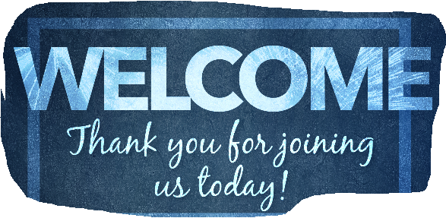
Tarnisha McLaughlin-Grayson Training Specialist Lead

Slide 2
What Motivates Me
Today’s Session
Define motivation
Discuss why its important
Identify ways you can tap into your individual work motivators
Take steps to create a more motivating work environment

Slide 3
Culture Works: Engagement Solved
Adrian Gostick & Chester Elton
Research Study: 850,000 people
Motivator Assessment
Job Sculpting
Additional Tools

Slide 4
What Drives YOU to Perform at Your Best?
Flexibility
Job Enrichment
Money
Creativity/Innovation
Fulfill – higher purpose
Teamwork
Other

Slide 5
Motivation Matters
Motivation: is defined as the needs, desires, wants that drive us to take action and accomplish our goals.
Reflection: List 3 reasons why you currently work for U of M-MM/Department/Team/Leader.

Slide 6
What Motivates You?

Slide 7
What Do YOU Find More Motivating?
Problem Solving
Coaching Others
Maintaining Work-Life Balance
Regular Recognition
Variety

Slide 8
What Do YOU Find More Motivating?
Working Under Pressure
Collaborating with Others
Having Fun @ Work
Prestige from Working @ U of M-MM
Impact of the Work

Slide 9
What Do YOU Find More Motivating?
Goal Setting
Serving Others
Respectful Work Environment
Rewards
Continuous Learning

Slide 10
What Motivates You?
The Achievers
The Thinkers
The Builders
23 Motivators
5 Identities
The Reward-Driven
The Caregivers

Slide 11
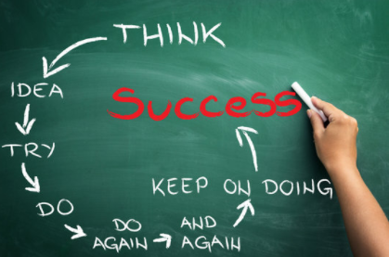
So What…Now What?
Define personal motivators
Identify more of…less of…
Create a plan/set a goal
Do you have the necessary skills?
Do you have the right connections?
What support is needed?
Take next step to a more motivating work environment

