Slide 1
Caring for Family Caregivers
Area Agency on Aging 1-B

Slide 2
Helping Seniors and Their Families
Nonprofit with a wide variety of services and supports to help older adults and their families
Serve Livingston, Macomb, Monroe, Oakland, St. Clair and Washtenaw counties
Part of a national network.
Two separate Area Agencies on Aging serve Wayne county.
Use Eldercare Locator website to find the AAA serving where your loved one lives.
800-852-7795
www.aaa1b.org

Slide 3
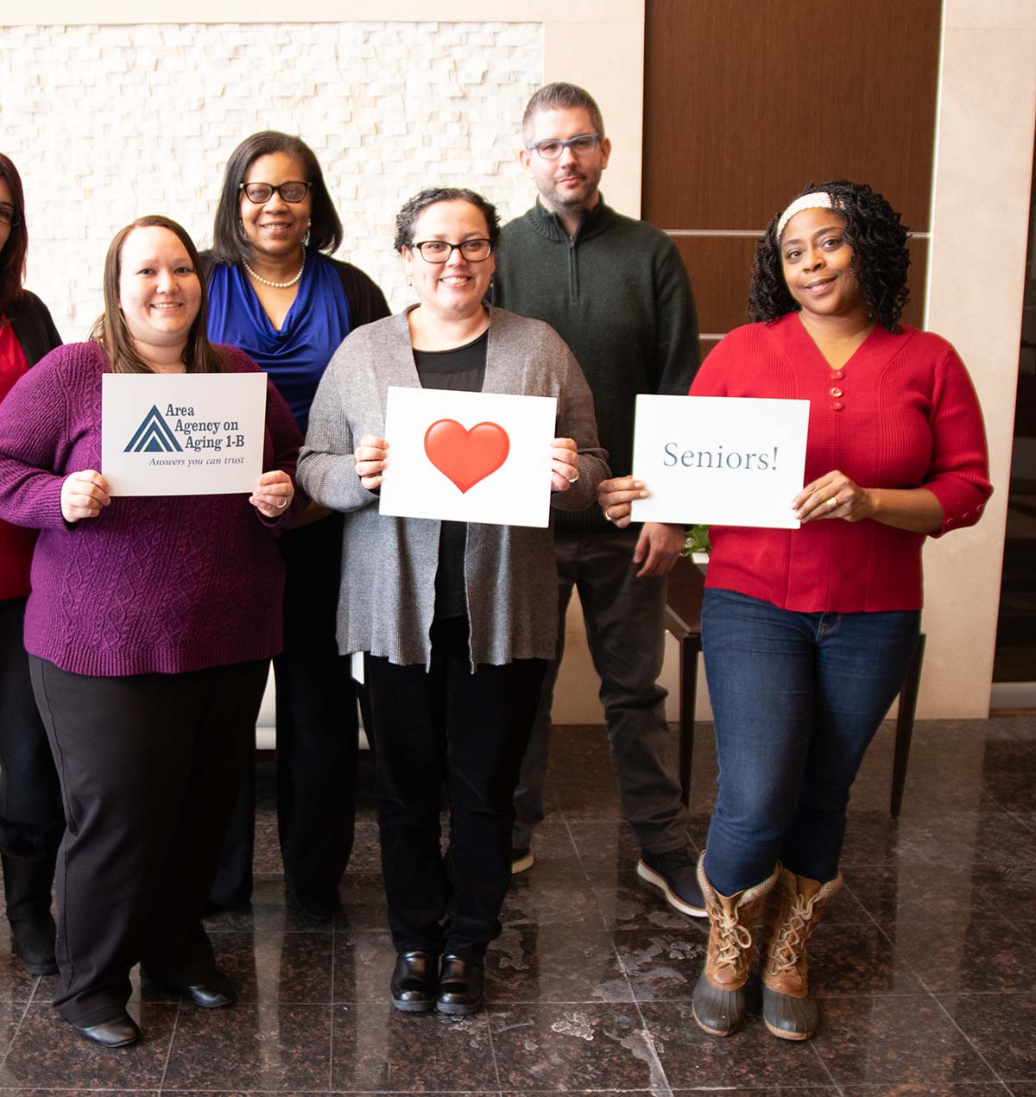
Programs That Can Help: Information and Assistance
Free phone help line for seniors and their families.
See if you qualify for one of our programs or get referrals to other programs.
First place to call when you or a loved one need help
800-852-7795

Slide 4
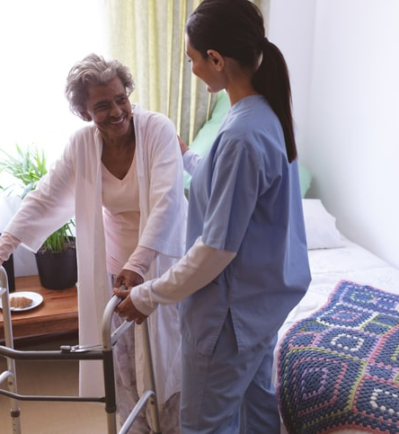
Programs That Can Help: In-home Care
The AAA 1-B offers two government-funded programs that can bring care into the home:
MI-Choice Medicaid Waiver
Community Living Program
Eligibility requirements apply to both programs.
Call to see if your loved one might be eligible.
800-852-7795
Notes:
MI Choice eligibility is $2,349 or less in monthly income. Individual assets limited to $2,000
MI Choice program available throughout state.
If your loved does not qualify, consider paying out of pocket for care.

Slide 5
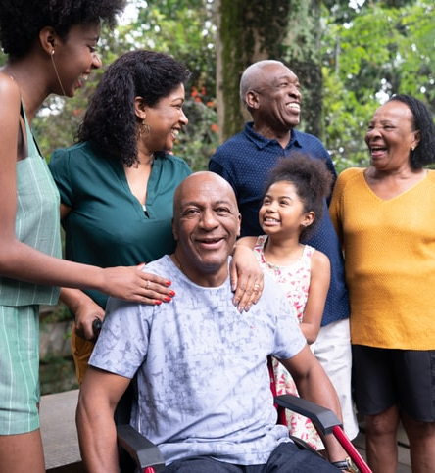
Programs That Can Help: MI Choice: Medicaid Waiver
Alternative to entering a nursing home
Comprehensive care at home
Can help support family caregivers
Available to seniors 65+ and adults with disabilities
Must need nursing home level care
Financial eligibility: $2,382 or less in monthly income/$2,000 or less in assets
800-852-7795
AAA 1-B has reduced its waitlist. Professionals encourage to refer!
Notes:
MI Choice eligibility is $2,349 or less in monthly income. Individual assets limited to $2,000
MI Choice program available throughout state.
If your loved does not qualify, consider paying out of pocket for care.

Slide 6
MI Choice Services May Include
Personal Care
Homemaking
Caregiver Respite (breaks)
Adult Day Services
Meal Preparation
Personal Emergency Response
Respite services
Environmental modifications
Non-medical transportation
Medical supplies and equipment not covered under the Medicaid State Plan
Chore services
Private duty nursing
Counseling
Home delivered meals
Training in a variety of independent living skills
Supports coordination

Slide 7
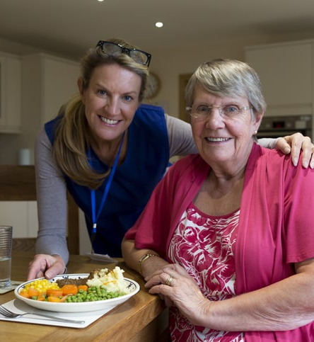
Programs That Can Help: Meals on Wheels
Weekday meals for those 60 and over who are homebound (unable to leave the home without assistance)
No financial eligibility. Voluntary donations accepted. The Area Agency on Aging 1-B helps support the Meals on Wheels program in six counties here in southeast Michigan (Livingston, Macomb, Monroe, Oakland, St Clair and Washtenaw).

Slide 8
Programs That Can Help: Health and Wellness Classes
Being offered virtually
Going all summer long
Matter of Balance
Diabetes PATH
Chronic Pain PATH
Aging Mastery

Slide 9
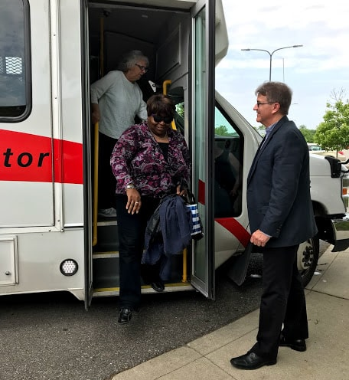
Programs That Can Help: myride2
Helps you understand your mobility options.
Helps to arrange rides.
Helps you to plan for “driving retirement.”
Offers training to help you understand how to use public transportation.
Serves Macomb, Oakland, Wayne and Washtenaw counites.
Now offering Lyft program!
855-697-4332
myride2.com

Slide 10
Programs That Can Help: MMAP
Our FREE Medicare Medicaid Assistance Program (MMAP) provides unbiased help with Medicare and Medicaid
Our team of certified volunteers:
Answers questions
Troubleshoots problems
Helps people understand their plan choices.
Help you understand if your loved one is eligible for programs that can reduce Medicare costs.
800-803-7174

Slide 11
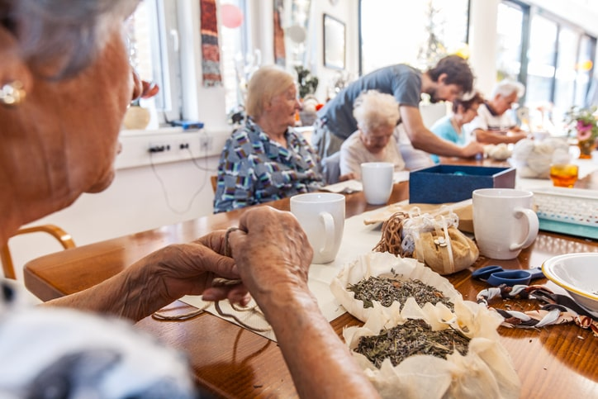
Programs That Can Help: Adult Day
Regular, weekday care for older adults who can’t be left alone or unsupervised.
Perfect for caregivers who work or want to have a regular, planned respite.
Includes stimulating activities, like art and music
Visit the AAA 1-B website, or call 800-852-7795, to find a center near you.

Slide 12
Programs That Can Help: Powerful Tools for Caregivers
Six-week program helps caregivers learn strategies to take care of themselves.
Classes are small—with only 8 to 12 people.
Going through the class together helps people get to know and learn from each other.
Now offering virtual classes! Visit aaa1b.org for a full class schedule.
1-day workshops for caregivers, as well.

Slide 13
Programs That Can Help: Caregiver Coaching
Free program that matches family caregivers with knowledgeable and empathic volunteers for 1-on-1 support.
Listening ear
Help find resources
Help sort through hard decisions
Meet as often or as little as the caregiver needs/wants

Slide 14
Programs That Can Help: connect
Information and resource guide.
Articles on long-term care, caregiving and aging
Local resource listings for each of the six counties we serve
Download at aaa1b.org/connect.

Slide 15
Almost everything will work again if you unplug it for a few minutes, including you.
-Anne Lamott

Slide 16
Call Us! And Keep in Touch!
Phone: 800-852-7795 | Online: aaa1b.org | Email: Subscribe to our e-news | Social: Connect on facebook and Twitter

