Slide 1

SECURE 2.0 Roth Mandate
How to Add the
SECURE 2.0 Act Roth Contributions

Slide 2
What can you do?
Available January 1, 2026
SECURE Act Roth 403(b) SRA
and
SECURE Act Roth 457(b)

Slide 3
2026 Roth Age 50 Catch-up Contribution
Contribution | Annual Maximum | Monthly Paycheck | Bi-weekly Paycheck
SECURE Act Roth 403(b) SRA | $8,000 | $667 | $308
SECURE Act Roth 457(b) | $8,000 | $667 | $308

Slide 4
2026 Roth Age 60-63 Catch-up Contribution
Contribution | Annual Maximum | Monthly Paycheck | Bi-weekly Paycheck
SECURE Act Roth 403(b) SRA | $11,250 | $938 | $433
SECURE Act Roth 457(b) | $11,250 | $938 | $433

Slide 5
.
You do not have to wait to hit $24,500
before you add the
SECURE 2.0 Act Roth contributions

Slide 6
What are my options?
You do not need to lower your 403(b) SRA and/or 457(b) amount to stay within $24,500
  Consider leaving it alone
Payroll will cap it at $24,500
Add the SECURE 2.0 Act Roth contributions

Slide 7
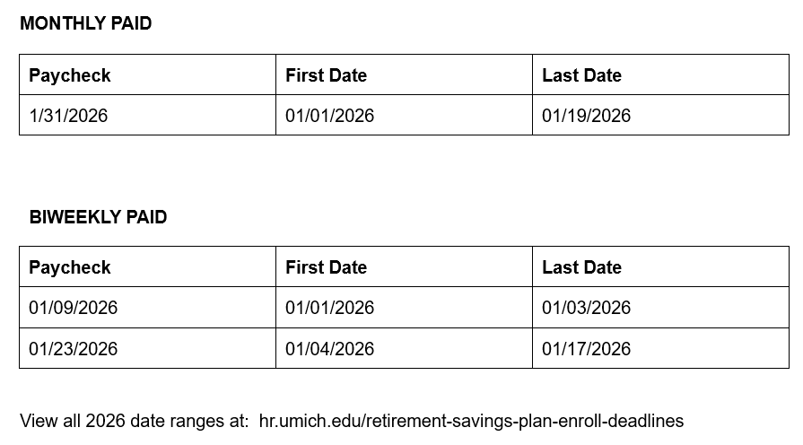
Date Range to Add SECURE 2.0 Act Roth Contributions

Slide 8
How often will the SECURE 2.0 Act affect me?
You may add or change your
SECURE Act Roth contribution
throughout the year.
It is not limited to just January

Slide 9
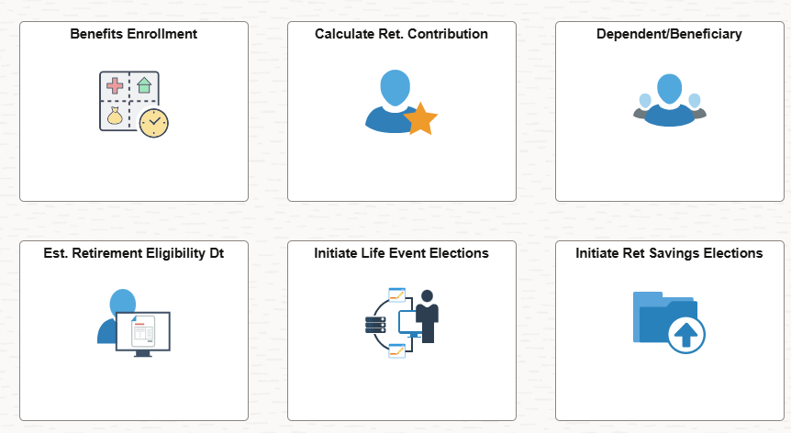
Employee Self Service > Benefits > Initiate Ret Savings Elections

Slide 10
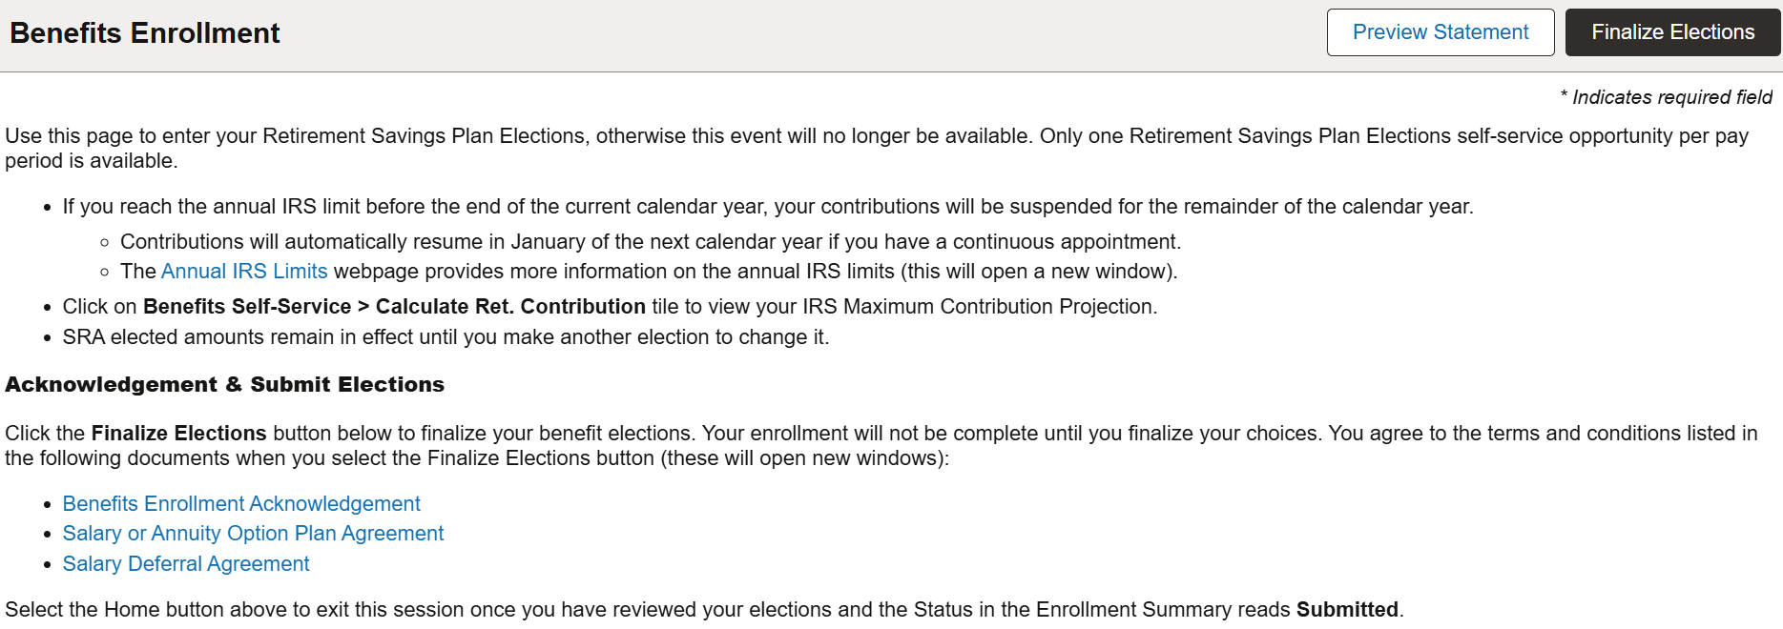
Retirement Plan Election Page

Slide 11
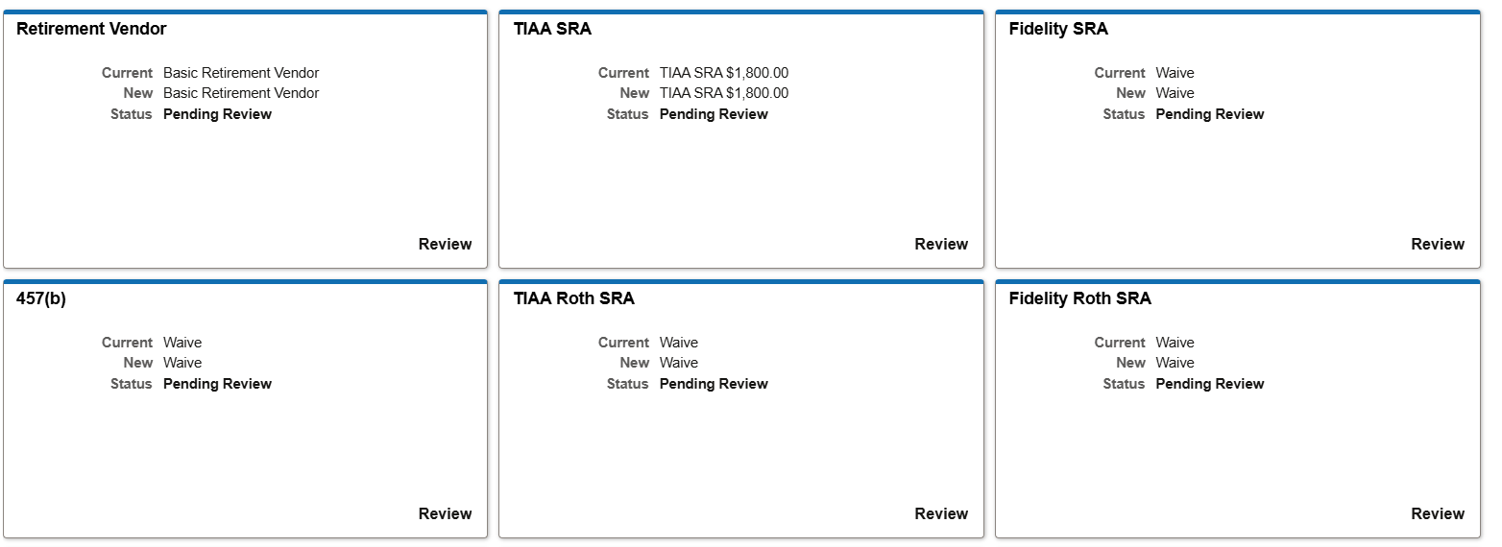
Page Down to the Enrollment Tiles

Slide 12
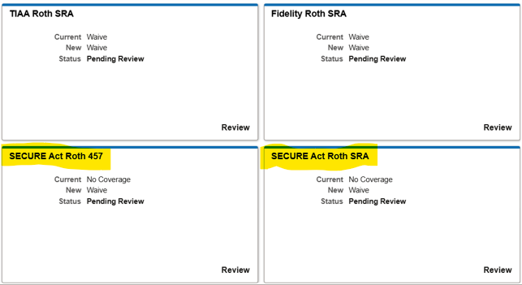
Page Down to View SECURE 2.0 Act Contributions

Slide 13
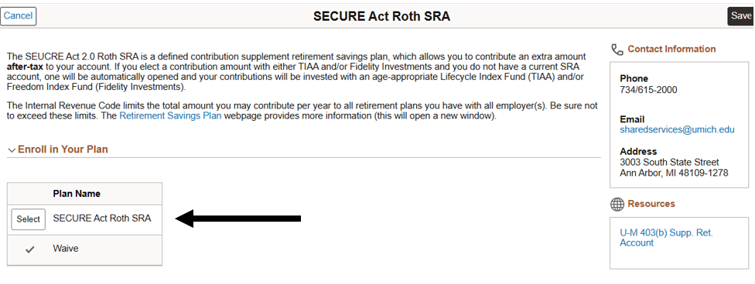
Choose “Select” to Enter Your Contribution

Slide 14
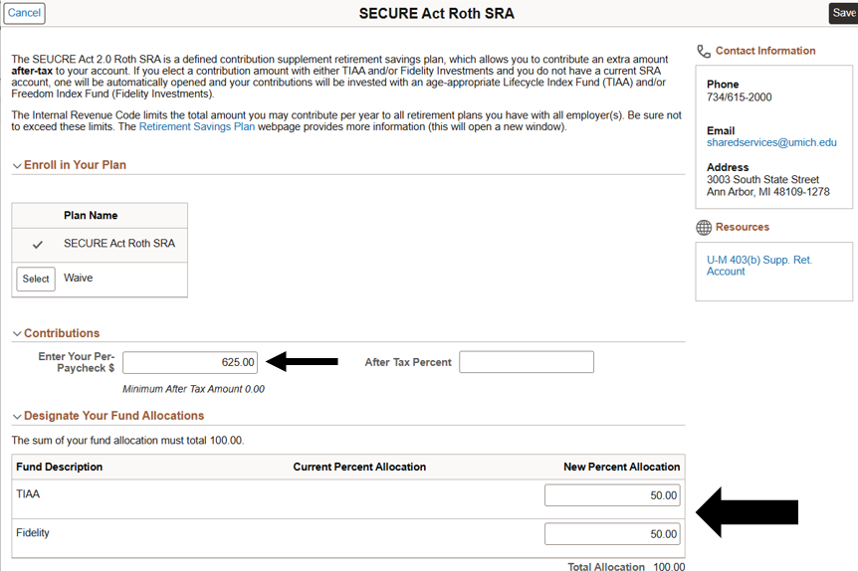
Enter Amount and Vendor Allocation

Slide 15
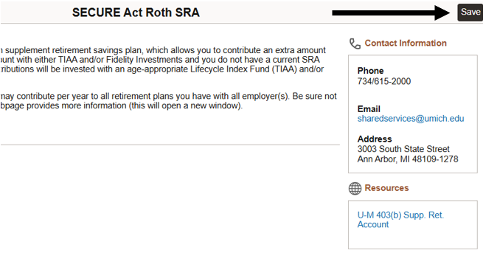
Page up and select “Save”

Slide 16
Go Back to Make Any Other Elections

Slide 17
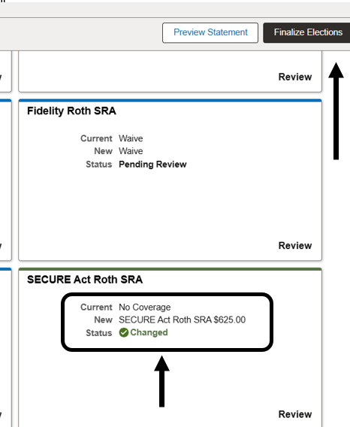
Confirm Election; Select “Finalize Elections”

Slide 18
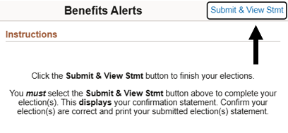
Finally, select “Submit & View Stmt”

Slide 19
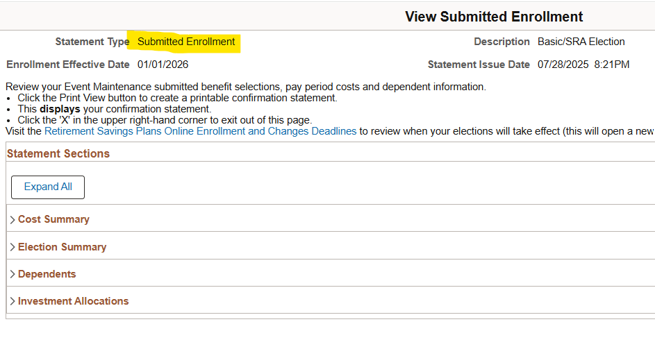
If you don’t see this, you didn’t finish it

Slide 20
Questions?
Call Shared Service Center (SSC)
HR Customer Care at (734) 615-2000
Monday through Friday, from 8 a.m. to 5 p.m.
Visit the Retirement Plan Website
hr.umich.edu/retirement-savings-plans

Slide 21
DISCLAIMER and Limitations
The following is an overview of federal limits on retirement plan contributions and how these limits apply to the University of Michigan Basic Retirement Plan, the 403(b) Supplemental Retirement Account, and the 457(b) Deferred Compensation Plan. The examples contained herein are based on a person who is subject to the SECURE 2.0 Act Roth mandate for 2026. This information is based on the university’s current understanding of highly complex Internal Revenue Code (IRC) and U.S. Treasury Department regulations. It is provided for general informational purposes only. Not every situation is covered by these materials. The University of Michigan does not provide tax advice. It is the responsibility of the employee as a plan participant to comply with federal tax limits. Questions or concerns regarding these limits, including aggregation of contributions with other retirement plans, should be addressed to a qualified tax adviser. Every effort has been made to ensure the accuracy of information in this material. Internal Revenue Code regulations, as well as University of Michigan and investment company policies, are subject to change and/or correction without notice. The University of Michigan in its sole discretion may modify, amend, or terminate the retirement savings programs. Nothing in these materials gives any individuals the right to continued plan benefits beyond those accrued at the time the university modifies, amends, or terminates the plans. Anyone seeking or accepting any of the benefits provided will be deemed to have accepted the terms of the plans and the university’s right to modify, amend, or terminate the plans.
December 2025

