Slide 1
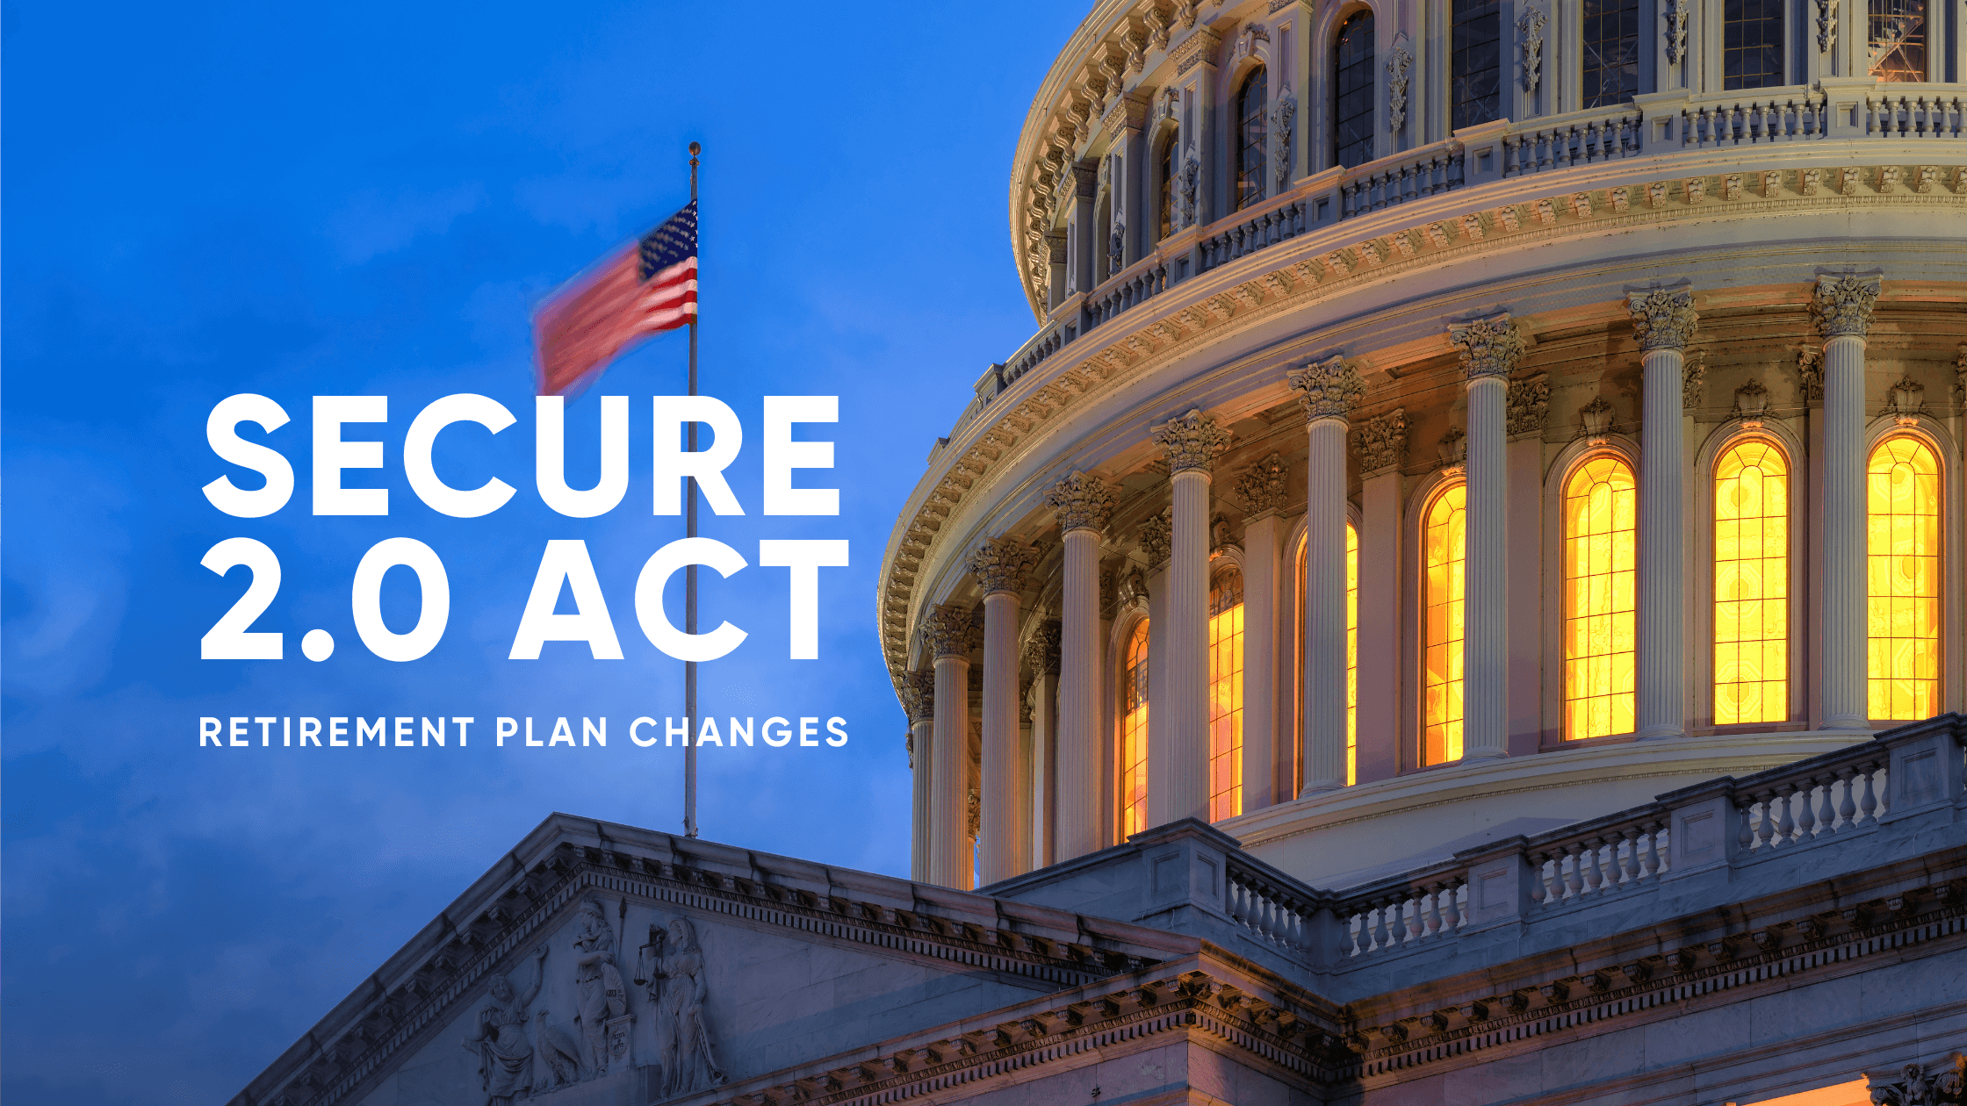

Secure 2.0 Act

Slide 2
.
This slide deck has been updated
to reflect the 2026 contribution limits
that were released by the IRS on 11/14/2025.
The limits and examples referenced in this presentation differ from an earlier version.

Slide 3
Things to keep in mind
Not every scenario will be covered
Personal situations will not be addressed
This is not tax advice
Consult with a qualified tax adviser
Based on current understanding of Secure 2.0 Act

Slide 4
UHR Benefits Office
Check the UHR Benefits Office website for updates and new content.
The Benefits Office will send email updates as January draws closer and you need to take action.

Slide 5
Questions
Burning Questions

Slide 6
Who The Roth Mandate Affects
Does the Secure 2.0 Act
Roth Mandate Affect You?

Slide 7
Who the Roth Mandate Affects cont.
Are you age 50 or older?
Do you have more than $150,000 in Social Security FICA tax wages for 2025?
Do you want to contribute more than $24,500 to the 403(b) SRA and/or 457(b) for 2026?

Slide 8
What Changes
You may no longer make pre-tax age 50 catch-up contributions to the 403(b) SRA and 457(b)
Age 50 catch-up contributions are those you make in excess of the $24,500 General Limit
Those contributions can only be Roth

Slide 9
The Roth Mandate
Takes effect 1/1/2026
Does not affect 2025

Slide 10
Earnings Review is Done Every Year
The wage review is conducted every year to determine if you exceed the $150,000 threshold
  Based on U-M W-2 wages subject to Social Security FICA tax
  Does not include income reported on a 1099
  Does not include income from non-university sources
  Based on your U-M income, not your total household income
  If you work part time for U-M, it is based on your actual income and not a full-time equivalent calculation

Slide 11
FICA Tax Wage Threshold
If you exceed the $150,000
FICA tax wage threshold
the Roth mandate applies to you
for the following calendar year

Slide 12
.Social Security FICA Tax Wages for 2025
If your Social Security FICA tax wages
exceed $150,000 for 2025
you will be subject to
the Roth mandate for 2026

Slide 13
Pre-Tax Contributions
Your pre-tax contributions to the retirement programs will not reduce your FICA tax wages
You cannot avoid the Roth mandate by making significant pre-tax contributions to the 403(b) and 457(b) retirement plans

Slide 14
.Changes to FICA Tax Wages
You may or may not be subject to
the Roth mandate from one year to the next
if your U-M FICA tax wages change

Slide 15
Notification
The Benefits Office will send you
an email every December
if you are subject to the Roth mandate
for the following year

Slide 16
. The Roth Mandate
Does not affect your 5%
Does not affect the U-M 10%
Does not affect an IRA or Roth IRA

Slide 17
Earnings Limit
The earnings limit that can prevent you
from having a Roth IRA
does not apply to the U-M Roth plans

Slide 18
2025 Limits (pre-tax and Roth)
*Includes the 5% 403(b) contribution you make to the Basic Retirement Plan.
**The catch-up returns to $31,000 starting at age 64.
Plan | General Limit | Age 50 Catch-Up | age 60-63 Catch-up**
403(b) SRA* | $23,500 | $31,000 | $34,750
457(b) | $23,500 | $31,000 | $34,750
Total | $47,000 | $62,000 | $69,500

Slide 19
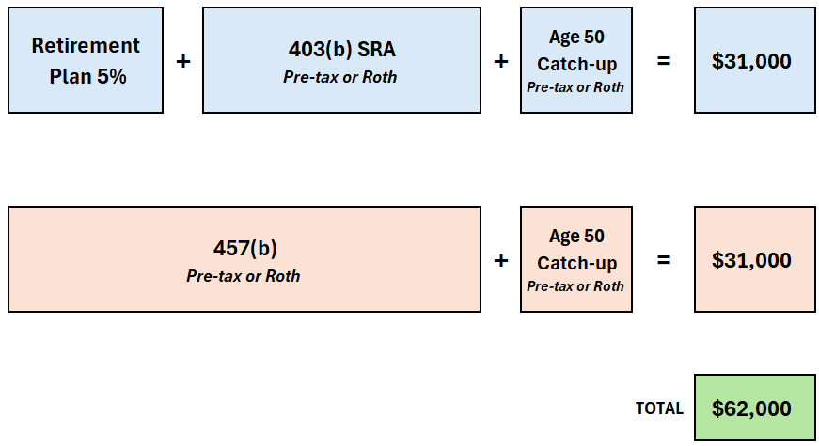
2025 Maximum Contribution

Slide 20
2026 Limits (pre-tax)
*Includes the 5% 403(b) contribution you make to the Basic Retirement Plan.
Plan | General Limit | Age 50 Catch-Up | age 60-63 Catch-up
403(b) SRA* | $24,500 | N/A | N/A
457(b) | $24,500 | N/A | N/A
Total | $49,000 | N/A | N/A

Slide 21
Starting 2026
Your 403(b) and 457(b) contributions
may still be pre-tax or Roth
up to the general limit of $24,500

Slide 22
Starting 2026 cont.
Age 50 catch-up contributions*
can only be Roth
they cannot be pre-tax
*Up to $8,000 | *Up to $11,250 if 60-63

Slide 23
Starting in 2026
Your 403(b) and 457(b) contributions
(whether pre-tax or Roth)
will stop at $24,500 under each plan
unless you take action

Slide 24
Option 1
Secure Act Roth 403(b) SRA contribution
and/or
Secure Act Roth 457(b) contribution
New contributions you can add starting 1/1/2026
Allows you to make Roth age 50 catch-up contributions
  Up to $8,000 if 50 or older to each plan
  Up to $11,250 if 60-63 to each plan

Slide 25
Option 2
Shift or reallocate your age 50 pre-tax contributions that have to be Roth
and instead redirect them between the
403(b) SRA and 457(b) so that
each does not exceed $24,500

Slide 26
No Action
What Happens
If You Take No Action

Slide 27
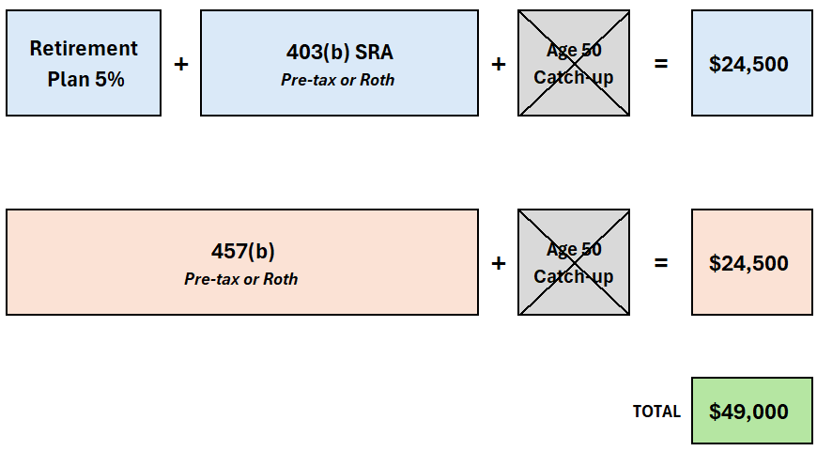
2026 Maximum Contribution If You Take No Action

Slide 28
.Age 50 Catch-Up
Do You Use
the Age 50 Catch-up?

Slide 29
W-2
Check Box 12 on Your W-2

Slide 30
W-2: Box 12 Codes
403(b) Contributions
457(b) Contributions
Code | What It Means
E | Pre-tax: Your 5% Basic Plan + SRA
BB | Roth 403(b) SRA
Code | What It Means
G | Pre-tax 457(b)
EE | Roth 457(b)

Slide 31
What To Do
What Can You Do?

Slide 32
Which Fits Your Scenario?
Status | You Contribute only to 403(b) SRA | You Contribute Only to 457(b) | You Contribute to the 403(b) SRA and 457(b) But You Contribute Less Than $24,500 to One of Them | You Contribute Over $24,500 to the 403(b) SRA and 457(b)
Option | Consider adding the pre-tax 457(b) | Consider adding the pre-tax 403(b) SRA | Consider increasing the pre-tax contribution to the plan you contribute less than $24,500 to | Consider adding the SECURE 2.0 Act Roth contributions
Why | This redirects age 50 Roth catch-up contributions in the 403(b) SRA to the 457(b) as pre-tax | This redirects age 50 Roth catch-up contributions in the 457(b) to the 403(b) SRA as pre-tax | This redirects age 50 Roth catch-up contributions across the 457(b) and 403(b) SRA | Since you contribute more than $24,500 to both plans, there is no room left to make pre-tax contributions to either one
Outcome | Allows you to make pre-tax contributions in the 457(b) and sidestep the Roth mandate | Allows you to make pre-tax contributions in the 403(b) SRA and sidestep the Roth mandate | Allows you to continue making pre-tax contributions and sidestep the Roth mandate | Allows you to continue making contributions but they must be Roth

Slide 33
Option 1: Add Secure Act Roth Contributions
Contribute more than $24,500
to the 403(b) SRA and/or 457(b)
by adding the new
Secure Act Roth contributions

Slide 34
. Available January 1, 2026
Secure Act Roth 403(b) SRA
and
Secure Act Roth 457(b)

Slide 35
Roth Age 50 Catch-up Contribution
Contribution | Annual Maximum | Monthly Paycheck | Bi-weekly Paycheck
Secure Act Roth 403(b) SRA | $8,000 | $667 | $308
Secure Act Roth 457(b) | $8,000 | $667 | $308

Slide 36
Roth Age 60-63 Catch-up Contribution
Contribution | Annual Maximum | Monthly Paycheck | Bi-weekly Paycheck
Secure Act Roth 403(b) SRA | $11,250 | $938 | $433
Secure Act Roth 457(b) | $11,250 | $938 | $433

Slide 37
. Secure Act Roth Contributions Accounts
The Secure Act Roth contributions
do not open a new 403(b) SRA or 457(b)
account at TIAA or Fidelity

Slide 38
. Roth Contribution in Existing Accounts
They just take the Roth contribution
and add it into your existing
403(b) SRA and/or 457(b) account

Slide 39
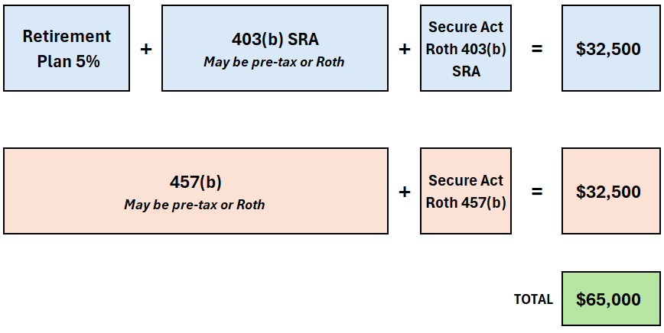
If You Add the Secure Act Roth Contributions

Slide 40
Add Secure Act Roth Contributions
You do not have to wait to hit $24,500
before you add the
Secure Act Roth contributions

Slide 41
Example
You contribute $26,000 in 403(b)
5% 403(b) to Basic Retirement Plan
and
403(b) SRA

Slide 42
403(b) Contributions
General Limit | $24,500
Age 50 catch-up | $1,500
Total | $26,000

Slide 43
Contribution Example
Catch-up contribution: $1,500
Number of paychecks: 12
Monthly Secure Act Roth 403(b) SRA: $125

Slide 44
Contribution Panel
Contribution calculator panel will show how much you may contribute to each plan:
5% Basic
403(b) SRA
New Secure Act Roth 403(b) SRA
New Secure Act Roth 457(b)

Slide 45
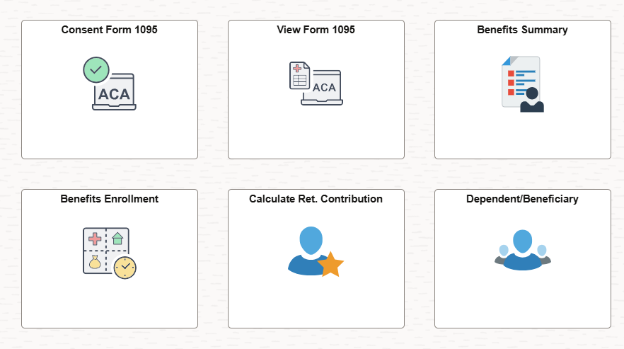
Employee Self Service > Benefits > Calculate Ret. Contribution

Slide 46
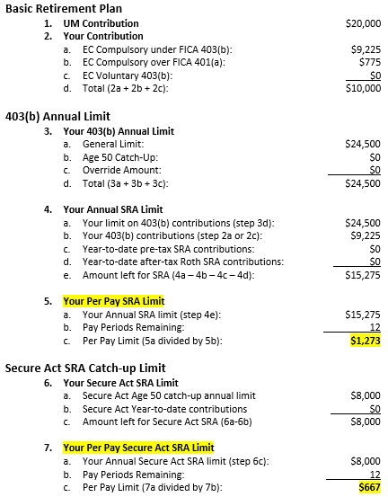
Panel Shows All Three Limits

Slide 47
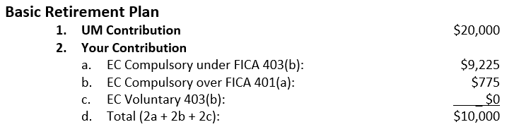
Basic Plan Limit

Slide 48
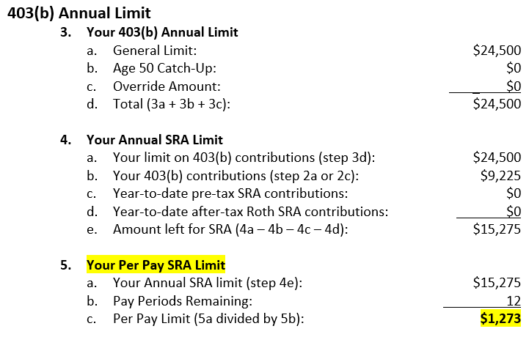
403(b) SRA Limit

Slide 49
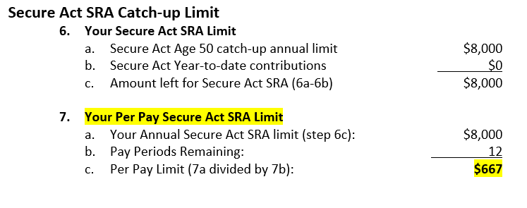
Secure Act Roth 403(b) SRA Limit

Slide 50
Option 2: Shift Your Pre-tax Contributions
You want to contribute
more than $24,500 to the
403(b) SRA and/or 457(b)

Slide 51
Pre-Tax, Not Roth
But as pre-tax
not as Roth

Slide 52
. Sidestep the Roth mandate
Reallocate your pre-tax contributions
between the 403(b) SRA and 457(b)
so that each does not exceed $24,500

Slide 53
53
Status | You Contribute only to 403(b) SRA | You Contribute Only to 457(b) | You Contribute to the 403(b) SRA and 457(b) But You Contribute Less Than $24,500 to One of Them | You Contribute Over $24,500 to the 403(b) SRA and 457(b)
Option | Consider adding the pre-tax 457(b) | Consider adding the pre-tax 403(b) SRA | Consider increasing the pre-tax contribution to the plan you contribute less than $24,500 to | Consider adding the SECURE 2.0 Act Roth contributions
Why | This redirects age 50 Roth catch-up contributions in the 403(b) SRA to the 457(b) as pre-tax | This redirects age 50 Roth catch-up contributions in the 457(b) to the 403(b) SRA as pre-tax | This redirects age 50 Roth catch-up contributions across the 457(b) and 403(b) SRA | Since you contribute more than $24,500 to both plans, there is no room left to make pre-tax contributions to either one
Outcome | Allows you to make pre-tax contributions in the 457(b) and sidestep the Roth mandate | Allows you to make pre-tax contributions in the 403(b) SRA and sidestep the Roth mandate | Allows you to continue making pre-tax contributions and sidestep the Roth mandate | Allows you to continue making contributions but they must be Roth

Slide 54
. If you don’t contribute to both accounts
If you don’t contribute to both
the 403(b) SRA and the 457(b)

Slide 55
How to sidestep the Roth mandate
Add the one you don’t have
to continue pre-tax contributions
and sidestep the Roth mandate

Slide 56
Contributions
If you only contribute to the 403(b) SRA…
…add the 457(b)

Slide 57
.Continue Making Pre-Tax Deferrals
Redirect your pre-tax age 50 catch-up contributions that now have to be
Roth in the 403(b) SRA
to the 457(b) so you can
continue making pre-tax deferrals

Slide 58
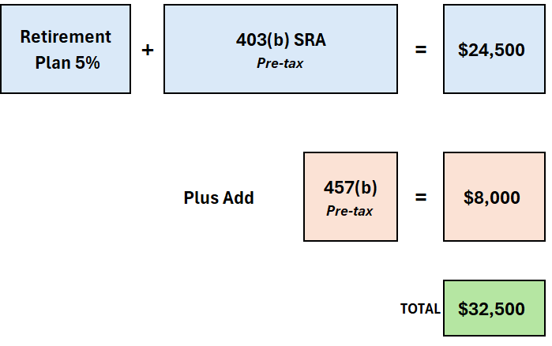
Add 457(b) to Continue Pre-tax

Slide 59
.Contributing
If you only contribute to the 457(b)…
…add the 403(b) SRA

Slide 60
.Pre-Tax Deferrals
Redirect your pre-tax age 50 catch-up contributions that now have to be
Roth in the 457(b)
to the 403(b) SRA so you can
continue making pre-tax deferrals

Slide 61
Less Than $24,500
If you contribute to both the
457(b) and 403(b) SRA…
…but less than $24,500 to one of them

Slide 62
Increase Pre-Tax Deferrals
Consider increasing
the pre-tax deferrals
to the plan you contribute
less than $24,500

Slide 63
For this approach to work
The pre-tax age 50 contributions you redirect
Plus
The contributions you already make to the receiving plan must total no more than $24,500

Slide 64
Contribute More Than $24,500
If you contribute more than $24,500
to both the
457(b) and the 403(b) SRA…

Slide 65
No Room for Pre-Tax Deferrals
Since you contribute more than
$24,500 to both plans
there is no room left to make
pre-tax deferrals to either one

Slide 66
Next
What’s Next

Slide 67
. Mid-December 2025
You will receive an email if you are subject
to the Roth mandate for 2026

Slide 68
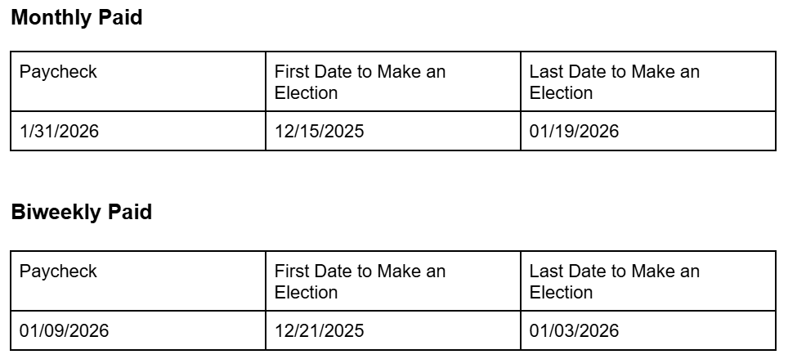
Date Range to Reallocate Pre-tax

Slide 69
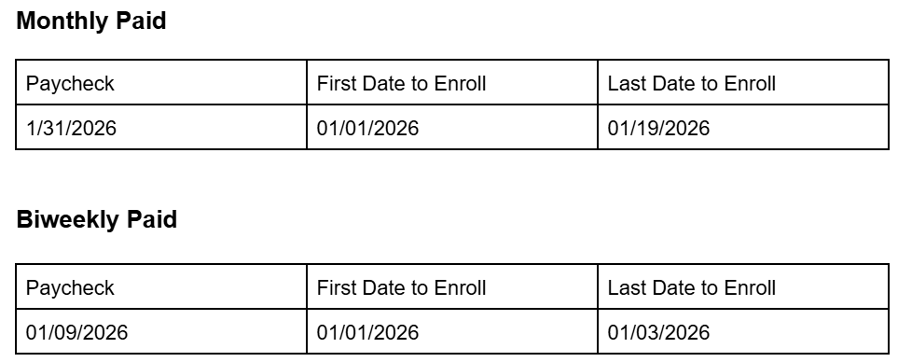
Date Range to Add Secure Act Roth Contributions

Slide 70
Defer More Than $24,500
How to defer more than $24,500
using Secure Act Roth contributions

Slide 71
.Staying Within $24,500
You do not need to lower your 403(b) SRA and/or 457(b) amount to stay within $24,500.
  Consider leaving it alone
Payroll will cap it at $24,500
Add the Secure Act Roth contributions

Slide 72
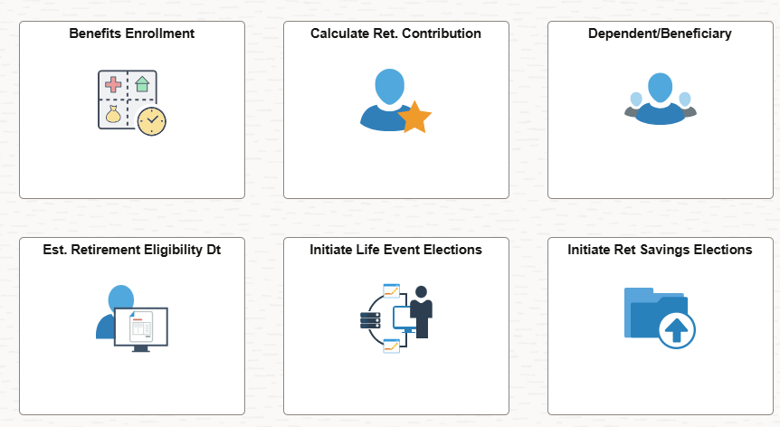
Benefits Self-Service in Wolverine Access

Slide 73
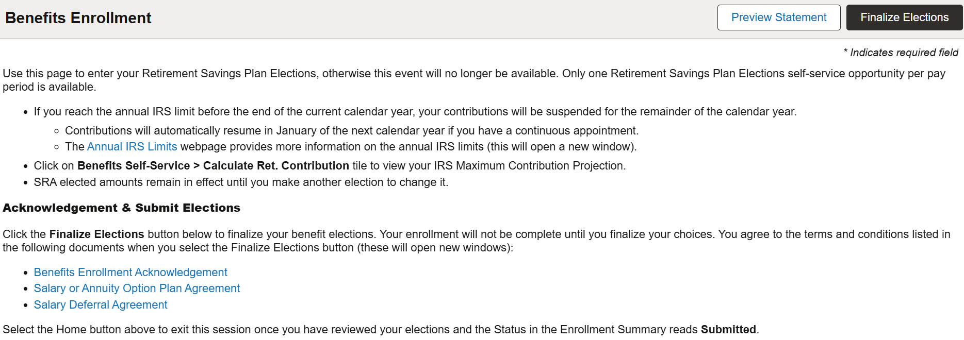
Retirement Plan Election Page

Slide 74
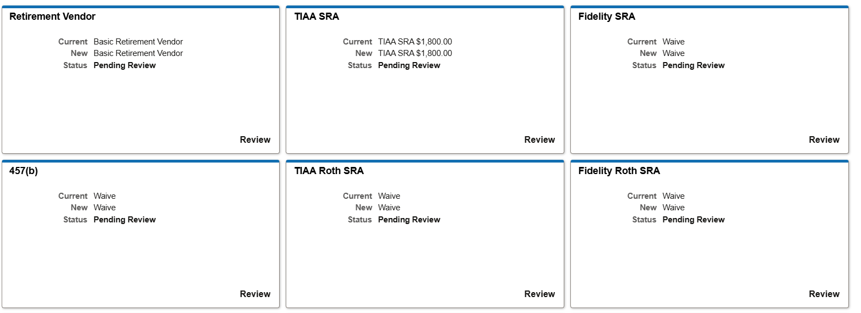
Page Down to the Enrollment Tiles

Slide 75
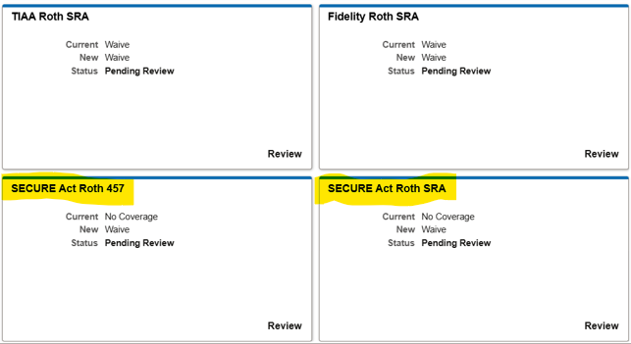
Page Down to View Secure Act Contributions

Slide 76
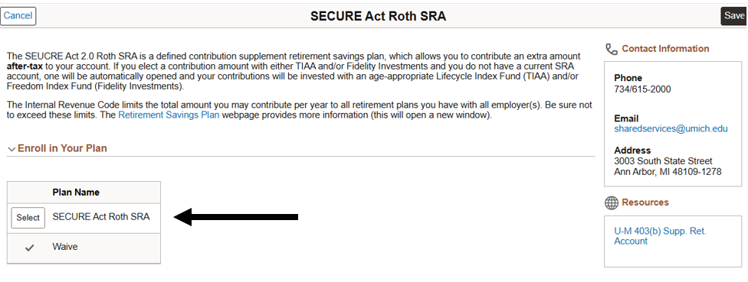
Choose “Select” to Enter Your Contribution

Slide 77
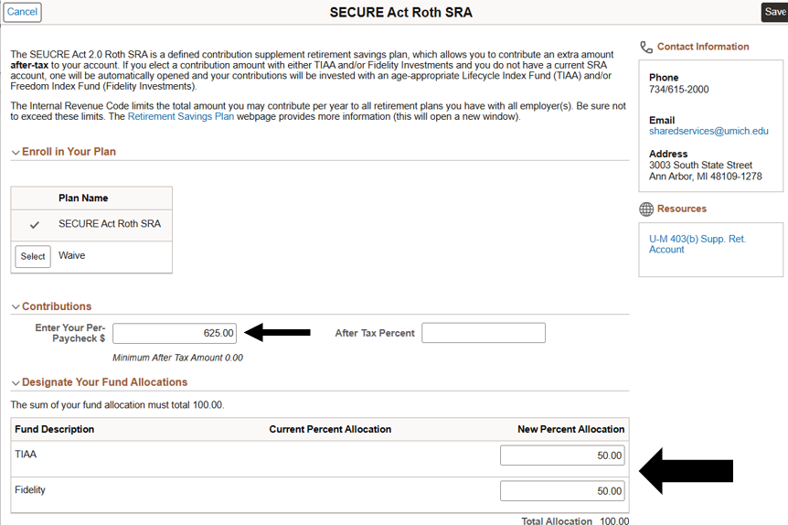
Enter Amount and Vendor Allocation

Slide 78
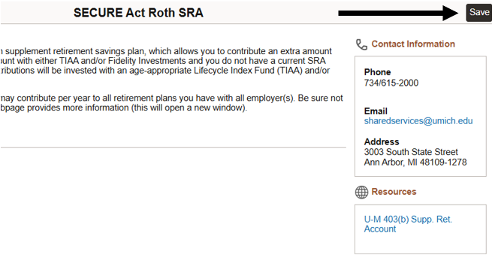
Page up and select “Save”

Slide 79
Go Back to Make Any Other Elections

Slide 80
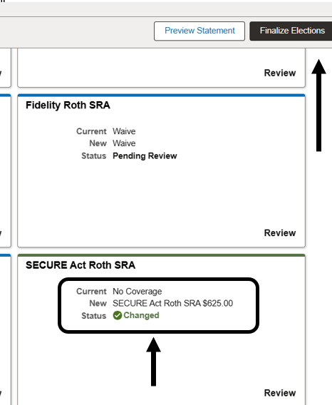
Confirm Election; Select “Finalize Elections”

Slide 81
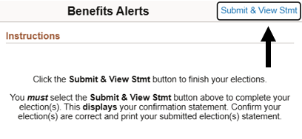
Finally, select “Submit & View Stmt”

Slide 82
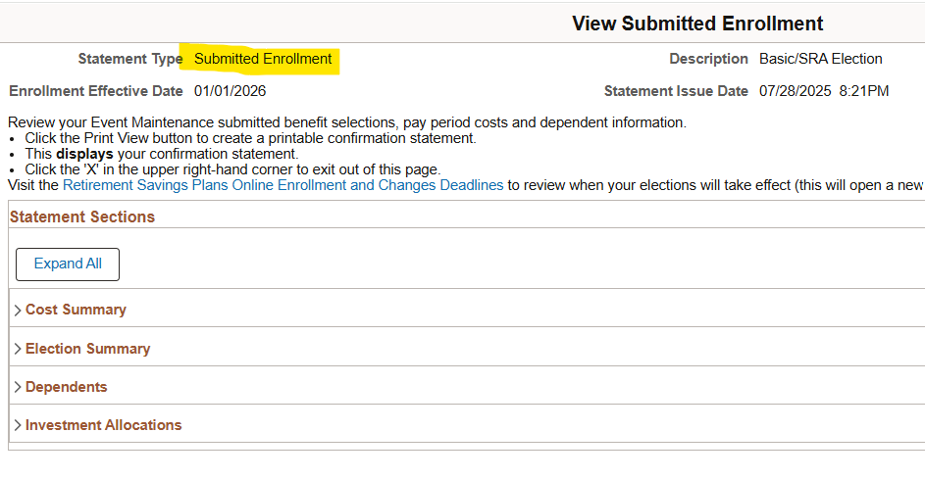
If you don’t see this, you didn’t finish it

Slide 83
.Changes Throughout the Year
You may add or change your
Secure Act Roth contribution
throughout the year;
It is not limited to just January

Slide 84
Do Now
Things You Can Do Now

Slide 85
Steps to Take Now
Meet with a financial planner
Review your current contributions
Determine what action you want to take

Slide 86
86
Status | You Contribute only to 403(b) SRA | You Contribute Only to 457(b) | You Contribute to the 403(b) SRA and 457(b) But You Contribute Less Than $24,500 to One of Them | You Contribute Over $24,500 to the 403(b) SRA and 457(b)
Option | Consider adding the pre-tax 457(b) | Consider adding the pre-tax 403(b) SRA | Consider increasing the pre-tax contribution to the plan you contribute less than $24,500 to | Consider adding the SECURE 2.0 Act Roth contributions
Why | This redirects age 50 Roth catch-up contributions in the 403(b) SRA to the 457(b) as pre-tax | This redirects age 50 Roth catch-up contributions in the 457(b) to the 403(b) SRA as pre-tax | This redirects age 50 Roth catch-up contributions across the 457(b) and 403(b) SRA | Since you contribute more than $24,500 to both plans, there is no room left to make pre-tax contributions to either one
Outcome | Allows you to make pre-tax contributions in the 457(b) and sidestep the Roth mandate | Allows you to make pre-tax contributions in the 403(b) SRA and sidestep the Roth mandate | Allows you to continue making pre-tax contributions and sidestep the Roth mandate | Allows you to continue making contributions but they must be Roth

Slide 87
Questions?
Call Shared Service Center (SSC)
HR Customer Care at (734) 615-2000
Monday through Friday, from 8 a.m. to 5 p.m.
Visit the Retirement Plan Website
hr.umich.edu/retirement-savings-plans

Slide 88
DISCLAIMER and Limitations
The following is an overview of federal limits on retirement plan contributions and how these limits apply to the University of Michigan Basic Retirement Plan, the 403(b) Supplemental Retirement Account, and the 457(b) Deferred Compensation Plan. The examples contained herein are based on a person who is subject to the Secure 2.0 Act Roth mandate for 2026. This information is based on the university’s current understanding of highly complex Internal Revenue Code (IRC) and U.S. Treasury Department regulations. It is provided for general informational purposes only. Not every situation is covered by these materials. The University of Michigan does not provide tax advice. It is the responsibility of the employee as a plan participant to comply with federal tax limits. Questions or concerns regarding these limits, including aggregation of contributions with other retirement plans, should be addressed to a qualified tax adviser. Every effort has been made to ensure the accuracy of information in this material. Internal Revenue Code regulations, as well as University of Michigan and investment company policies, are subject to change and/or correction without notice. The University of Michigan in its sole discretion may modify, amend, or terminate the retirement savings programs. Nothing in these materials gives any individuals the right to continued plan benefits beyond those accrued at the time the university modifies, amends, or terminates the plans. Anyone seeking or accepting any of the benefits provided will be deemed to have accepted the terms of the plans and the university’s right to modify, amend, or terminate the plans.
November 2025

