Slide 1

U-M Benefits Orientation
HEALTH &
WELL-BEING
CULTURE
& CLIMATE
EFFECTIVENESS
& EFFICIENCY

Slide 2
INTRODUCTION TO U-M BENEFITS
2

Slide 3
Who Is Eligible for Benefits?
Benefits eligibility is based on:
  Your job
  The number of hours you work
  The length of your appointment
You may enroll in coverage for yourself, as well as a spouse or other qualified adult (OQA) and any dependent children
(up to age 26).
hr.umich.edu/benefits-eligibility
3

Slide 4
How Do I Enroll?
As a new hire, you will enroll online through Wolverine Access > New Hire > Benefits Self-Service for everything except flexible spending accounts.
Your benefits options will be shown after 8 p.m. on
your hire date or after your appointment is processed by your department and entered online; whichever is later.
As a new hire, you have 30 days to enroll.
You may enroll in or change elections to retirement savings plans, life insurance or long-term disability at any time.
wolverineaccess.umich.edu
4

Slide 5
Can I Change My Benefits Later?
You are eligible to participate in annual Open Enrollment if your hire date is before mid-October of a calendar year.
If you are hired any time from mid-October through Dec. 31, your first chance to change your benefit elections will be during Open Enrollment the year after you're hired, unless you experience a qualifying event:
  Includes changes in legal marital status, number of dependents, employment status, residence or work site, or domestic relations court order
5

Slide 6
How Much Do Benefits Cost? (1)
Monthly rates for certain plans are standard:
  Dental, vision and legal plans
Others are based (in part) on your salary:
  Health, life insurance, and long-term disability plans
U-M pays a portion of your benefits;
you pay the rest through payroll deductions.
6

Slide 7
How Much Do Benefits Cost? (2)
View general rate information on our website.
View your personal benefit plan rates on Wolverine Access: search for Benefits Self-Service and select the tile; then select the Display Benefit Plan Rate tile.
hr.umich.edu/benefits-rates
http://wolverineaccess.umich.edu/
7

Slide 8
Do You and Your Spouse/Other Qualified Adult
Both Work at U-M?
Choose the medical insurance coverage that best meets the needs of you and your dependents at the lowest cost.
Two adults who work at U-M and have no dependent children could minimize the amount of their employee premium contribution if each person chooses “You Only” coverage.
When there are two adults and one child or more, the lowest medical premium contribution is achieved when one person
chooses “You Only” coverage and the other chooses coverage for “You + Child” or “You + Children.”
Both employees should review their rates by going to Wolverine Access, searching for Benefits Self-Service and selecting the tile, then selecting the Display Benefit Plan Rate tile.
8

Slide 9
Payroll Deductions for Benefits (1)
If you are paid bi-weekly, most deductions are taken from the first two paychecks of each month (24 equal amounts):
  There are two months with three paychecks
  No benefit deductions from third check except retirement contributions
If you are paid monthly, all deductions are taken from every paycheck.
payroll.umich.edu
9

Slide 10
Payroll Deductions for Benefits (2)
Always Pre-Tax: | Always After Tax:
Health Plan | Life Insurance
Dental Plan | Long-Term Disability
Vision Plan | Legal Services Plan
Flexible Spending Account
Basic Retirement Plan
Choose Pre-Tax or After Tax (Roth):
403(b) SRA and 457(b) Deferred Compensation
10

Slide 11
HEALTH PLANS
11

Slide 12
Health Plans Overview
Choose from 4 health plans
  Comprehensive Major Medical (CMM)
  Community Blue PPO
  Consumer-Directed Health Plan (CDHP) with Health Savings Account (HSA)
  U-M Premier Care (must live in service area)
GradCare plan exclusively for grad students
All plans include prescription drug coverage
hr.umich.edu/health-plans
12

Slide 13
Before Choosing a Plan, Consider . . .
Whether you prefer:
  Higher monthly premiums with lower out-of- pocket costs (copays, deductibles, coinsurance)
  Lower monthly premiums with higher out-of-pocket costs
Access to your preferred doctors and hospitals
Residency requirements for you and your dependents
Anticipated health needs over the next year
13

Slide 14
Do You Need a Primary Care Provider?
Michigan Medicine has limited new patient appointments with
select primary care providers (PCPs) for current benefits-eligible
U-M employees and dependents.
This process is for people without a current U-M Health PCP.
Appointment availability depends on location and provider;
openings are filled on a first-come, first-served basis.
PCPs may include nurse practitioners, physician assistants
or physicians.
To establish care with a U-M Health PCP, call the
Employee First Appointment Line at (734) 539-5599.
– Be ready to provide your name and U-M uniqname.
– This line is for new patient appointment requests only;
please do not use for urgent medical matters.
Michigan Medicine manages this program, including provider locations and appointment availability.
14

Slide 15
Comparing Health Plans
CDHP | Lowest premium cost, higher deductible and out-of-pocket limit $1,700 individual/$3,400 family deductible Flexibility to see any provider When you enroll in the CDHP, you’re automatically enrolled into an HSA
CMM | Low monthly cost, higher out-of-pocket $500 individual/$1,000 family deductible Flexibility to see any provider
PPO | Higher monthly cost, lower copays in-network Flexibility to see out-of-network providers
UMPC | Moderate monthly cost, low copays PCP required, referral needed for specialist Local provider network, statewide option
 | For more information, go to hr.umich.edu/health-plans.
15

Slide 16
Benefits Mentor Online Decision Support Tool
Benefits Mentor can help you compare U-M’s Health Plans to select the one that fits your individual needs.
Benefits Mentor:
  Is a free, online, interactive tool
  Uses benchmark data to help you compare
  U-M Health Plans
  Analyzes info you list as important – such as cost, physician network and specific benefits – to help support your selection of a Health Plan
hr.umich.edu/benefits-mentor
16

Slide 17
Health Plan Resources
Health plan resources, including a tool to compare for health services offered by the plans and participating provider directories, are available on the HR website:
hr.umich.edu > Benefits and Wellness > Health Plans > Health Plan Forms and Documents
hr.umich.edu/health-plan-resources
hr.umich.edu/health-plan-forms-documents
17

Slide 18
PRESCRIPTION DRUG PLAN
18

Slide 19
U-M Prescription Drug Plan
Automatic enrollment for all participants enrolled in any U-M health plan.
Prescription drug ID card arrives from
Prime Therapeutics.
Fill prescriptions at any pharmacy in the
Prime Therapeutics network or by mail.
– Register with Birdi (mail order vendor) even before you need a prescription.
hr.umich.edu/prescription-drug-plan
19

Slide 20
Prescription Drug Plan Copays
Drug Type | Copay
Preventive (Affordable Care Act) | $0
Generic | $10
Preferred Brand Name | $20
Non-Preferred Brand Name | $75*
* Plus possible product selection penalty
No annual deductible or separate premium unless you choose the Consumer- Directed Health Plan (CDHP). With the CDHP, out-of-pocket prescription drug costs count toward the deductible. Once the deductible is met, then copays apply.
Fill through mail order to save one copay every three months
20

Slide 21
DENTAL PLAN
21

Slide 22
Dental Plan Overview
Administered by Delta Dental of Michigan (no card)
Choose Option 1, 2 or 3
Three things to consider:
  How much dental work do you think you and your family will need in the coming year?
  Does your dentist participate with Delta Dental PPO or Premier network?
  Monthly premium cost vs. out-of-pocket costs
hr.umich.edu/dental-plan
22

Slide 23
Diagnostic and Preventive Services
All three plan options cover:
Oral exams twice per calendar year
Cleanings twice per calendar year
Emergency treatment to relieve pain
Bitewing X-rays once per calendar year and full mouth X-rays once in any five-year period
Orthodontic services at 50% for eligible dependents up to age 19
23

Slide 24
Comparing Dental Options: Cost
Option 1 |  | Option 2 | Option 3
Monthly Premium | University pays in full | Moderate premium | Highest premium
Deductible* | No deductible | $50/person, $150/family | $50/person, $150/family
Other out-of- pocket costs | None for preventive, highest for basic/major services | Depends on type of service and dentist (PPO = lower) | Lowest
* Does not apply to diagnostic and preventive services, emergency treatment to relieve pain, occlusal guards, and orthodontics.

Slide 25
Comparing Dental Options: Coverage
Option 1 Option 2 Option 3
Preventive Services | 100% coverage | 100% coverage | 100% coverage
Basic Services* | Not covered | PPO = 100% Premier = 60% | 100% coverage
Major Services** | Not covered | PPO = 50% Premier = 40% | 50% coverage
Orthodontia
50% (up to age 19) with $1,500 lifetime limit
50% (up to age 19) with $1,500 lifetime limit
50% (up to age 19) with $1,500 lifetime limit
* Basic services = fillings, root canals, etc.
** Major services = crowns, implants, dentures, etc.
23

Slide 26
Choosing a Dentist
You can choose any dentist you want:
  Greatest savings with a Delta PPO provider
  Some savings with a Delta Premier provider
Delta PPO and Premier participating dentists
won’t bill more than Delta’s approved amount.
If you see a non-participating dentist, you will submit claims and pay any difference between the charges and Delta’s approved amount.

Slide 27
VISION PLAN

Slide 28
Vision Plan Overview
Administered by Davis Vision by MetLife (no card)
One eye exam and pair of eyeglasses per year
or standard, soft, daily-wear, disposable contacts in lieu of eyeglasses
Full provider list at Davis Vision by MetLife website
– Kellogg Eye Center is a participating provider
hr.umich.edu/vision-plan
metlife.com

Slide 29
FLEXIBLE SPENDING ACCOUNTS

Slide 30
Flexible Spending Accounts (FSA)
An FSA lets you put money aside before taxes to pay for eligible expenses.
Three types of accounts:
  Health Care FSA
  Limited Purpose FSA: Only for those enrolled in the CDHP
  Dependent Care FSA
Administered by Inspira Financial
Enroll by downloadable form or eForm, not Wolverine Access
hr.umich.edu/flexible-spending-accounts

Slide 31
Health Care FSA
Set aside pre-tax dollars for out-of-pocket health care expenses for you and your eligible dependents.
Use like a debit card or submit claims for reimbursement – keep receipts either way!
Your entire annual contribution amount is available to use right away.
hr.umich.edu/health-care-fsa

Slide 32
Limited Purpose FSA
Available only to employees enrolled in the Consumer-Directed Health Plan (CDHP).
Just like the Health Care FSA, except it can be used only to pay for vision, dental and orthodontic expenses, such as dental implants, Invisalign orthodontics, adult braces, prescription sunglasses and LASIK surgery.
hr.umich.edu/health-care-fsa

Slide 33
Dependent Care FSA
Set aside pre-tax dollars for out-of-pocket dependent day care expenses for your eligible dependents.
Must keep receipts and submit claims for reimbursement.
You can be reimbursed only up to the amount that is currently available in your account.
hr.umich.edu/dependent-care-fsa

Slide 34
Examples of Eligible Expenses
Health Care FSA
Prescription copays
Lasik surgery
Dental expenses
Doctor’s office copays
Hearing aids
Mental health care
Dependent Care FSA
Day care expenses
Private preschool
After-school care
Summer day camps
Care for disabled dependents
A complete list available on inspirafinancial.com.

Slide 35
FSA Contribution Limits
Health Care and Limited Purpose FSA
$3,300 individual annual maximum
$120 annual minimum
Dependent Care FSA
$7,500 household annual maximum
$120 annual minimum
You determine how much to contribute.
Provides immediate tax savings.
Dependent Care FSA limit may be affected by several factors.

Slide 36
FSA Example
Annual Savings Example | Has FSA | No FSA
Annual taxable income | $28,000 | $28,000
Annual contribution to FSA | ($1,500) | $0
Resulting taxable income | $26,500 | $28,000
Federal taxes and Social Security | ($9,447) | ($9,982)
After-tax spending, eligible expenses | $0 | ($1,500)
Real spendable income | $17,053 | $16,518
Annual tax savings | $535 | $0
NOTE: Potential tax savings shown for demonstration only. Actual savings will vary based on
individual tax situation. Please consult a tax professional for more information.
36

Slide 37
FSA Considerations
“Use it or lose it” rule:
  Estimate your annual expenses carefully
Contributions continue through Dec. 31:
  FSA enrollments do not carry over
  Must re-enroll each year if you wish to participate
Grace period for expenses through March 15.
Submit claims by May 31.
No mid-year contribution changes without a qualified change in status.

Slide 38
LIFE INSURANCE

Slide 39
Life Insurance Overview
One university-paid plan plus two additional options for more coverage:
  University Life Insurance Plan (automatic)
  Optional Life Insurance
  Dependent Life Insurance
Administered by MetLife.
You must name beneficiaries.
hr.umich.edu/life-insurance

Slide 40
University Life Insurance
$30,000 plan for eligible faculty and staff.
Covers you only and is paid by the university at no cost to you.
You are automatically enrolled.
You must name beneficiaries.

Slide 41
Optional Life Insurance
Options for additional coverage:
  $10,000
  $50,000
  1x salary up to 8x salary
You must enroll to participate (not automatic):
  30 days to enroll without a health statement
  Coverage of $650,000 or more always requires a
  health statement
Important: You will default to the higher standard (“smoker”) rate unless you change your status to “non-smoker.”
Covers simple will preparation.
hr.umich.edu/life-insurance

Slide 42
Optional Life Insurance Considerations
Coverage amounts and costs may increase:
  When your salary increases (if tied to salary)
  When you move to a higher age bracket
You may enroll or change your coverage
at any time:
  Health statement may be required
Important: When enrolling, review and update your “smoker” status. If you do not, you will default to the higher standard (“smoker”) rate, which will affect your monthly cost.

Slide 43
Designate Your Beneficiary
Any person you wish; may add or change at any time.
Important! Remember to update your beneficiary after life events such as marriage, divorce, birth or adoption of a child.
Make or change beneficiary designations on
MetLife’s website.
Separate process for designating your retirement savings plan beneficiaries (designations do not transfer between plans).
metlife.com/mybenefits

Slide 44
Dependent Life Insurance
You are always the beneficiary.
Spouse/OQA (health statement required)
$10,000, $25,000, $50,000 or $100,000
Children (no health statement required)
$2,000 per child or $5,000 per child
One rate covers all eligible children.
hr.umich.edu/dependent-life-insurance

Slide 45
LONG-TERM DISABILITY

Slide 46
Long-Term Disability Overview
LTD coverage provides financial protection if you become disabled and can no longer work.
Plan pays up to 65% of your salary, plus U-M pays to continue your benefits.
You pay the full cost for two years, then U-M pays the premium for salary up to a median annual salary indexed annually.
Enroll or change at any time. A health statement may be
required.
You can elect to pay for coverage on salary above the median
annual salary.
hr.umich.edu/long-term-disability

Slide 47
LEGAL SERVICES PLAN

Slide 48
Legal Services Plan Overview
Covers wills and estate planning, real estate matters, family law matters, debt defense, defense of civil lawsuits, preparation of legal documents, identity theft protection.
Immigration assistance
Administered by MetLife Legal Plans.
hr.umich.edu/legal-services-plan

Slide 49
RETIREMENT SAVINGS PLANS

Slide 50
Retirement Savings Plan
Three savings plan options, no pension or 401K
Enroll or change at any time:
Basic Retirement Plan:
403(b) and 401(a) defined contribution plan
403(b) Supplemental Retirement Account
457(b) Deferred Compensation Plan
Two investment companies
TIAA
Fidelity Investments
hr.umich.edu/retirement-savings-plans

Slide 51
Basic Retirement Plan
Eligible employees receive a 2-for-1 matching contribution.
You contribute 5%.
U-M's 10% match begins 12 months after your eligible service date, once you have enrolled.
Enroll or change your contributions at any time
in Wolverine Access.
Your contributions are pre-tax.
hr.umich.edu/basic-retirement-plan

Slide 52
Compulsory Participation
Basic Retirement Plan participation becomes compulsory when you are age 35 or older with two years of eligible service and a 100% appointment.
If you do not enroll, you will be automatically enrolled in the Reduced Benefit Option:
  U-M contributes 5%
  You contribute nothing
You can always choose to enroll as a regular participant and receive the full 2-for-1 match.

Slide 53
Access to Basic Retirement Plan Contributions
Cash withdrawals are available from employee 403(b) amounts for hardship or disability, or at age 59½ or older.
Former employees may cash out or roll over contributions and earnings at any age:
– IRS penalty for withdrawals before 59½ may apply
Loans are not available.

Slide 54
403(b) Supplemental Retirement Account (SRA)
Save more for retirement:
  Up to $24,500 per year if younger than age 50
  Up to $32,500 per year if 50 or older
  Up to $35,750 per year if age 60-63
  Includes 5% 403(b) contribution made to the Basic Retirement Plan
You decide how much to contribute:
  No U-M match
  Save on a pre-tax or after tax (Roth) basis
Enroll or change your contribution amount at any time in Wolverine Access.

Slide 55
457(b) Deferred Compensation Plan
Save even more for retirement:
  Up to $24,500 per year if younger than age 50
  Up to $32,500 per year if age 50 or older
  Up to $35,750 per year if age 60-63
You decide how much to contribute:
  No U-M match
  Save on a pre-tax or after tax (Roth) basis
Enroll or change your contribution amount at any time in Wolverine Access.

Slide 56
Access to 403(b) SRA and 457(b) Contributions
403(b) SRA
Withdrawals while employed for hardship or disability, or at age 59½ or older:
  Former employees may cash out at any age
  IRS penalty for withdrawals prior to 59½ may apply
457(b)
Withdrawals while employed at age 59½ or older, or for unforeseeable emergencies:
  Former employees may cash out at any age
403(b) SRA and 457(b) loans are available (with restrictions).
56

Slide 57
Investment Companies
Invest with TIAA or Fidelity, or both.
Allocate among a wide selection of funds.
You will receive a welcome packet from TIAA and/or Fidelity within about 30 days of
Enrollment.
Contact TIAA and/or Fidelity to designate your beneficiary:
– Not the same process as declaring your life insurance beneficiary.

Slide 58
Investment Fund Options
  Default investment options:
  - TIAA Lifecycle Index Fund
  - Fidelity Freedom Index Fund
  Default funds automatically select the
  right mix of investments for a target retirement date, becoming more conservative over time.
  Contact TIAA or Fidelity to change your investment choices.

Slide 59
Eligibility to Retire
Determined by a point system, 80 points to retire.
Points equal age plus years of continuous eligible service at U-M; need minimum 10 years of service.
Maximum university contribution for benefits after 20 years of service; pro-rationed if less than 20 years.
Health, prescription drug, dental, vision, legal, and life insurance coverage continues, if eligible; some or all of the monthly premiums are paid by the retiree.
hr.umich.edu/retirement-eligibility

Slide 60
Help with Retirement Savings
TIAA
Phone counseling center: (800) 842-2252
Local counseling appointments: (800) 732-8353
tiaa.org/umich
Fidelity
Phone counseling center: (800) 343-0860
Local counseling appointments: (800) 642-7131
netbenefits.com/uofm

Slide 61
HOW TO ENROLL IN BENEFITS

Slide 62
How To Enroll In Benefits
You will need a uniqname and UMICH password to log in to Wolverine Access.
wolverineaccess.umich.edu

Slide 63
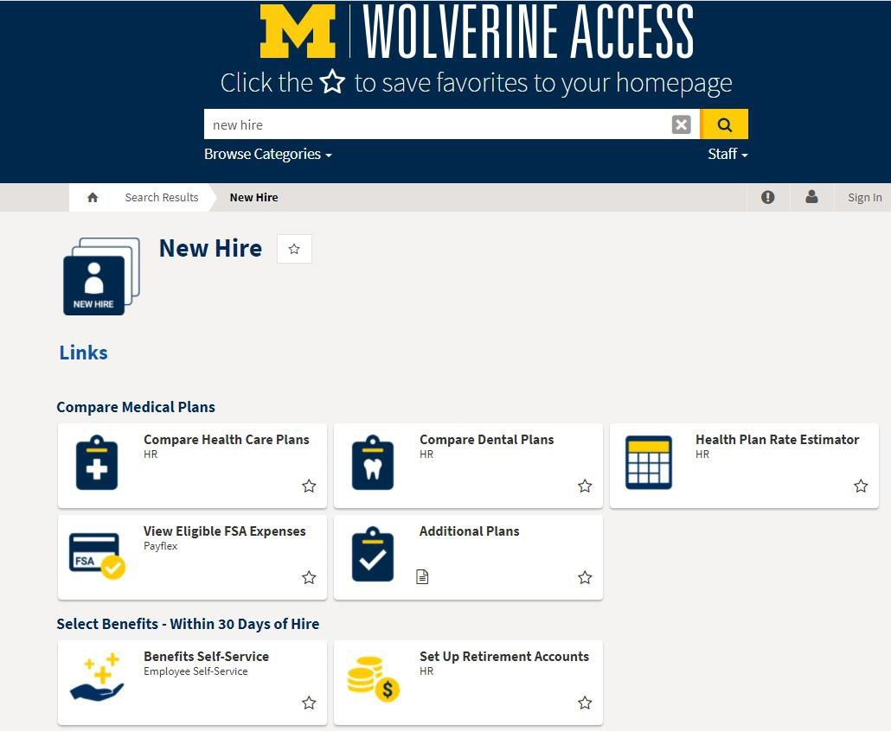

Wolverine Access (1)
For illustration only.
Your display may differ.
There are many ways to navigate through Wolverine Access and customize your homepage.
For quick access to benefits enrollment, enter new hire in the search bar, click the New Hire collection tile, then click the Benefits Self-Service tile.

Slide 64
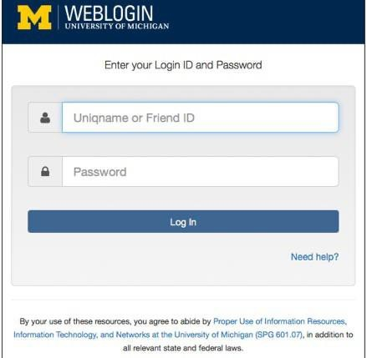
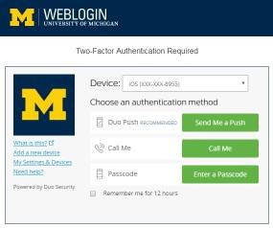
Wolverine Access (2)
Enter your uniqname and UMICH
password to log in.
If you have Duo two-factor authentication enabled, choose an authentication method.

Slide 65
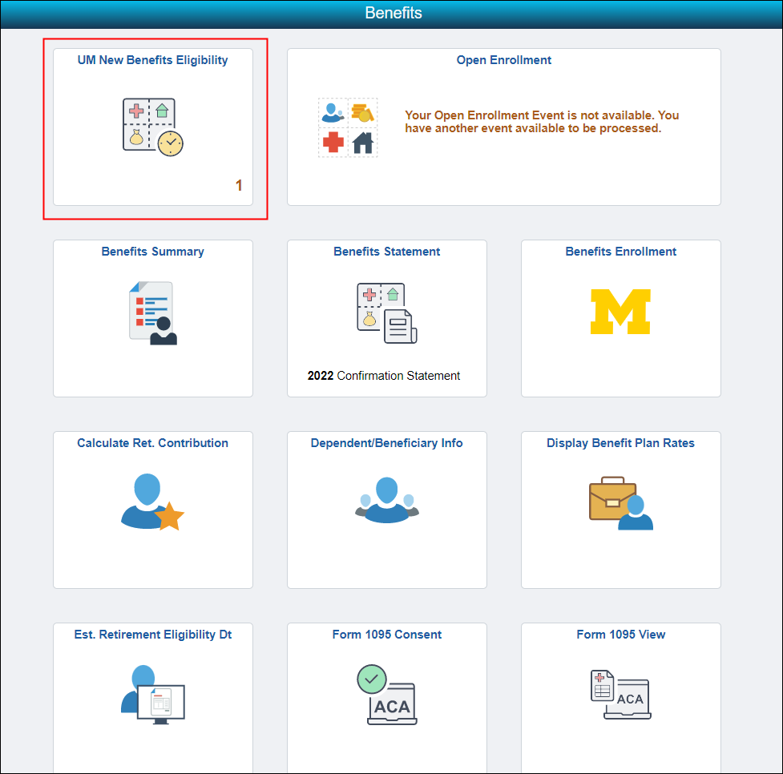

Wolverine Access “New Hire Event”
Click the UM New Benefits Eligibility tile to begin.

Slide 66
OTHER BENEFITS AND RESOURCES

Slide 67
Other Employee Benefits and Resources
MHealthy
Work-Life Resource Center
Faculty and Staff Counseling and Consultation Office (FASCCO)
Office of Counseling and Workplace Resilience
Mediation Services
Emergency Hardship Program
hr.umich.edu

Slide 68
CLOSING/REMINDERS

Slide 69
Closing/Reminders, Part 1
Review information on the UHR website at hr.umich.edu/benefits-wellness.
Call the Shared Services Center -
HR Customer Care at (734) 615-2000 if you have questions.
Check your benefits summary using the Benefits Self-Service tile on Wolverine Access.
Review your paycheck deductions.

Slide 70
Closing/Reminders, Part 2
Complete the Flexible Spending Account form and return as instructed on the form.
Be sure to read all U-M communications.
Emails go to uniqname@umich.edu addresses only. If you have an email address with a prefix (such as @med.umich.edu), set up forwarding to @umich.edu through MCommunity.

Slide 71
Important Reminders
If you have a life event, such as marriage, divorce, or a new baby, update your beneficiaries with MetLife for life insurance and with TIAA and Fidelity for retirement savings plans.
If you are a former U-M employee or student, update your personal information (name, address, phone numbers) with U-M.
If you move, update your address with
U-M, TIAA and Fidelity.

Slide 72
CONGRATULATIONS!

Slide 73
Limitations
The University of Michigan in its sole discretion may modify, amend, or terminate the benefits provided with respect to any individual receiving benefits, including active employees, retirees, and their dependents. Although the university has elected to provide these benefits this year, no individual has a vested right to any of the benefits provided. Nothing in these materials gives any individual the right to continued benefits beyond the time the university modifies, amends, or terminates the benefit. Anyone seeking or accepting any of the benefits provided will be deemed to have accepted the terms of the benefits programs and the university's right to modify, amend, or terminate them. Every effort has been made to ensure the accuracy of the benefits information in this site. However, if any provision on the benefits plans is unclear or ambiguous, the Benefits Office reserves the right to interpret the plan and resolve the problem. If any inconsistency exists between this site and the written plans or contracts, the actual provisions of each benefit plan will govern.
© 2026 Regents of the University of Michigan

