Slide 1
OCCUPATIONAL HEALTH SERVICES
FLU LIAISON VACCINATION PROGRAM

Slide 2
Liaison vaccination program
The Liaison Influenza vaccine program offers a convenient way for departments to increase vaccination rates. By designating staff to vaccinate coworkers, Occupational Health Services can expand access to the flu vaccine throughout the health system. We encourage departments with the ability to provide flu vaccines to participate in the program.
Requirements:
The department /unit/clinic must have a designated medication refrigerator that utilizes the TempTrak monitoring system.
Vaccinators must be trained in administering intramuscular injections. Roles include nurses, medical assistants, pharmacists, PAs, and physicians.
To designate a liaison, contact Daisy Demlow at daisyv@med.umich.edu .
OCCUPATIONAL HEALTH SERVICES

Slide 3

Same as last year, flu vaccines will not go to MiChart but will be sent to MCIR (the state registry). MiChart patient records will update when the immunization inquiry is visited within the chart and will display immunizations from MCIR.
Medical Record Numbers (MRNs) are no longer required to receive a flu shot. The only requirement is a badge.
OCCUPATIONAL HEALTH SERVICES

Slide 4

IMPORTANT!
CHECK YOUR OMNICELL / FRIDGES BEFORE PICKING UP OR RECEIVING FLU VACCINE FROM OHS TO ENSURE THAT YOU DO NOT HAVE ANY FLU VACCINE FROM LAST FLU SEASON.
OCCUPATIONAL HEALTH SERVICES

Slide 5
Obtaining Flu vaccine from Occupational Health Services
For University Hospital, CVC, Cancer Center, Children Women’s Hospital, UH South, and Taubman Outpatient clinics
Flu vaccine can be picked up from Occupational Health Services, 3rd Floor Med Inn during office hours 8:00am – 4:00pm.
Do not attempt to order flu vaccine for employees from B2 Pharmacy.
High Dose Flu vaccine (for 65+ y.o) and FluBlok (egg-free) are available to pick up upon request. These will only be distributed by doses needed due to limited supply. FluMist is only available at OHS by appointment.
For offsite locations including primary care and specialty care centers
Click on the OHS offsite flu vaccine request
to place an order for flu vaccine to be delivered to your site.
Do not attempt to order flu vaccine for employees from B2 Pharmacy.
High Dose Flu vaccine (for 65+ y.o) and FluBlok (egg-free) are available to pick up upon request. These will only be distributed by doses needed due to limited supply. FluMist is only available at OHS by appointment.
OCCUPATIONAL HEALTH SERVICES

Slide 6
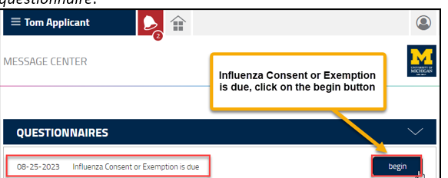
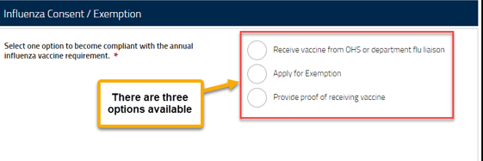
STEPS FOR EMPLOYEES TO FOLLOW IN ORDER TO
RECEIVE A FLU VACCINE FROM A LIAISON
BEFORE an employee can receive a vaccine from a department flu liaison, they will need to complete the Influenza Questionnaire in their Enterprise Health Portal
Log into the Enterprise Health Portal with their level 1 sign in.
Click on the Bell icon to see new messages
3. Under Questionnaires, begin the Influenza consent or Exemption Questionnaire.
4. Select the option to receive vaccine from OHS or department flu liaison.
5. Complete the Questionnaire and Submit.
OCCUPATIONAL HEALTH SERVICES

Slide 7
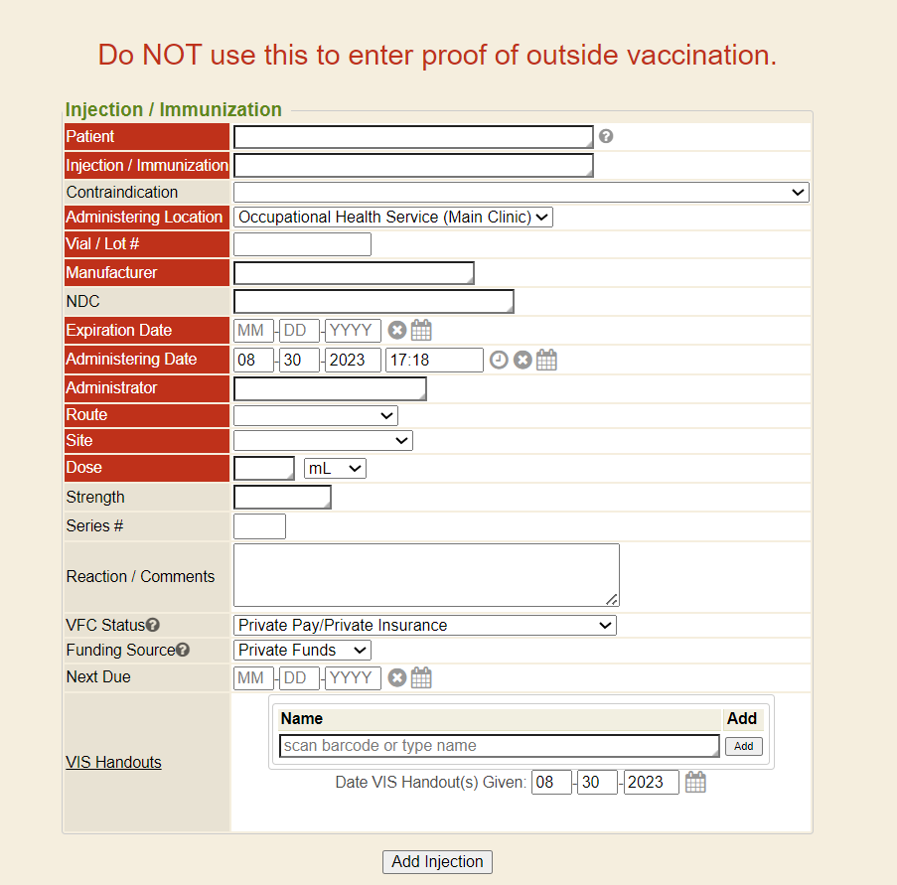
ENTERPRISE HEALTH DOCUMENTATION
FOR FLU LIAISONS
Go to https://enterprise-health.umich.edu/
Log in with your Level 1 password
As a liaison, you will be directed to this screen for documentation:
OCCUPATIONAL HEALTH SERVICES

Slide 8
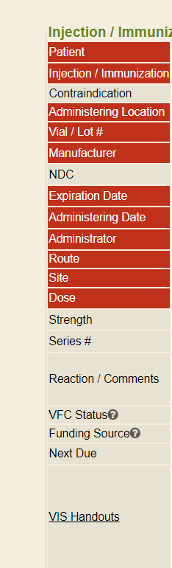
ENTERPRISE HEALTH DOCUMENTATION
FOR FLU LIAISONS
The fields in red are required.
Patient: You can look up a patient by name or their UMID. MRNs are not used in Enterprise Health.
Location: Liaison location
Injection/Immunization : Select
Influenza IIV3 (P-free, inj). The selections will populate as soon as you begin typing.
Vial/Lot #: This field is free text but it will remember the last lot# that was entered (until you log out).
Manufacturer: ID Biomedical
Expiration date: use date on box
OCCUPATIONAL HEALTH SERVICES

Slide 9
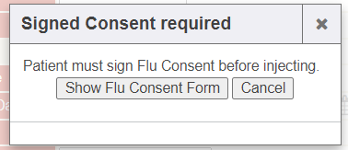
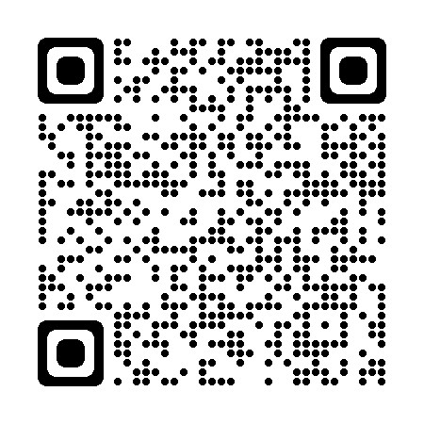
ENTERPRISE HEALTH DOCUMENTATION
FOR FLU LIAISONS
If you get this pop-up box:
.
The employee hasn’t completed their questionnaire yet. They must complete it in their portal before they can receive a flu vaccine.
Direct them to their Enterprise Health Patient portal at https://enterprise-health.umich.edu/
Or QR code:
OCCUPATIONAL HEALTH SERVICES

Slide 10
ENTERPRISE HEALTH DOCUMENTATION
FOR FLU LIAISONS
DO NOT use the flu injection page to enter flu vaccine proof !
They must submit it through their portal in Enterprise Health. Direct them to: https://enterprise-health.umich.edu/
Or QR code:
OCCUPATIONAL HEALTH SERVICES

Slide 11
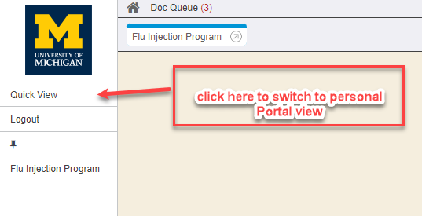
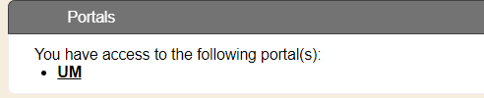

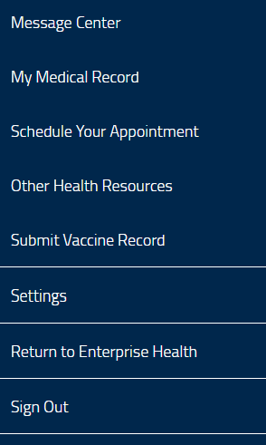
To access your own portal in Enterprise Health, click on Quick view in the left panel:
Under Portals, Click UM
To return to the injector screen, click on Return to Enterprise Health under the menu.
OCCUPATIONAL HEALTH SERVICES

Slide 12
IMPORTANT DATES
November 1, 2024: Deadline to submit Medical or Religious Exemption Requests
November 30, 2024: Flu vaccine return. Please return unused flu vaccine to OHS. If you are done vaccinating in your area, it can be returned earlier. Do not return it to B2 Pharmacy!
December 1, 2024: Flu vaccine deadline
Contact Information
For medical or clinical questions:
Email: OccupationalHealth-RN@med.umich.edu
For compliance, Enterprise Health, or vaccine questions:
Daisy Demlow
Program Manager
Office: 734-936-9244
Pager: 60545
Email: daisyv@med.umich.edu
OCCUPATIONAL HEALTH SERVICES

Slide 13
Clinical Procedure for Influenza Administration
Storage:
Store vaccine syringes at 35-46 degrees F. Do not freeze.For transport/temporary storage, you may pack vials of vaccine in their boxes in a cooler with cool packs. Be sure to place a barrier between boxes and cold packs to avoid freezing.
Preparation:
Shake syringe to re-suspend vaccine. Attach appropriate size needle to syringe. It is not necessary to dispel all the air out of the syringe prior to injection.
Administration:
Provide Vaccine Information Statement (VIS) for review.
Prefilled single dose syringes are latex and preservative free. They do not contain thimerosol or latex.
Gloves are not necessary when administering intramuscular injections since bleeding is not anticipated. If a blood spill occurs, wipe spill with alcohol solution and wash and sanitize hands. If hands are chapped or abraded, gloves should be worn.
Hands must be cleansed with alcohol skin sanitizer between patients. If hands become visibly soiled, soap and water must be used
Clean deltoid site with alcohol. Non dominant arm is preferred in case of local tenderness/swelling.
Flu vaccine is administered intramuscularly into the deltoid muscle at a 90 degree angle. Use a 22-25 g needle at least one inch in length to ensure penetration into muscle, not subcutaneous tissue. In obese individuals, use 1.5” needle. No need to aspirate prior to injection.
If an individual is taking blood thinning agents, care must be taken to apply pressure to the site after IM administration to prevent bleeding.

Slide 14
Assessment/management of vaccine reactions in adult patients:
Localized:
Soreness, itching or swelling at injection site. Apply cold compress to site.
Slight bleeding: Apply compressive bandage. If bleeding continues, apply direct and firm pressure and observe.
Near syncope (usually vagal reaction): Lie patient down with feet elevated. Assess airway, blood pressure/pulse and consciousness.
Anaphylaxis: Generalized itching or hives, angioedema (swelling of lips, face or tongue), wheezing, shortness of breath, hypotension, faintness.
Call for physician backup if in immediate area or 999 (or 911 for offsite areas).
Protect airway.
Administer 0.3-0.5 cc of 1:1000 dilution of aqueous epinephrine IM (IM is preferable to SQ) (Epi Pen gives 0.3 cc)
Administer diphenydramine 50-100 mg orally or 50-100 mg IM
Monitor patient; assess vital signs and consciousness every 5 minutes. Call 999 (or 911 for offsite areas) if vital signs deteriorate or patient loses consciousness. Begin CPR as appropriate.
May repeat epinephrine dose after 10 minutes for up to 3 doses.
Syncope: Check for neck/head injury before moving patient. Lie supine with feet elevated. Assess breathing, blood pressure and pulse. If consciousness not immediately regained, call 999 (or 911 for offsite areas).
Contraindications/Precautions
Previous severe allergic reaction to an influenza vaccine, regardless of the component suspected to be responsible for the reaction.
History of Guillain-Barre within six weeks of receiving a prior flu vaccine.
Fever > 101.5 F (38.6 C).
Medications that thin blood (except aspirin): not a contraindication but need to apply pressure after injection. May alter the INR in patients taking warfarin.
Egg/chicken allergy: The CDC recommendations have changed to allow administration of influenza vaccine for those with mild allergies to eggs. Employees with concerns regarding an egg allergy reaction to a flu vaccine should be referred to Occupational Health Services for vaccine.

Slide 15


